Slide 1
Community Data Science meets Digital Heritage
Controversies about World Heritage Sites in the Online Community of Wikipedia
Ben Marwick
University Associate Professor
of Washington
@benmarwick
Digital Heritage in a World of Big Data
13 and 14 May 2019, at University of Stirling
Code & data online at: https://github.com/benmarwick/Stirling-May-2019-digital-heritage-big-data

Slide 2
Community
Notes:
Wikipedia:

Slide 3
Data Science
Notes:
How to analyse?

Slide 4
Digital Heritage
Notes:
Meskell?

Slide 5
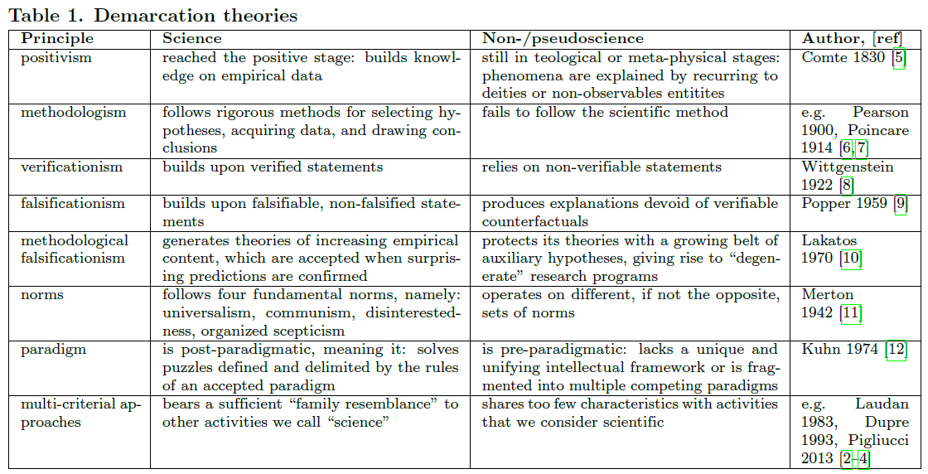
The approaches for determining what is and is not a science, are themselves not very scientific
Cherry-picking isolated examples, uncontrolled, not empirical
Fanelli, D., Pickett, C. L., Tilghman, S., Specht, H., Slavov, N., Leitner, P., ... & Ross-Ibarra, J. (2018). A theory and methodology to quantify knowledge. PeerJ Preprints. https://doi.org/10.7287/peerj.preprints.1968v5

Slide 6
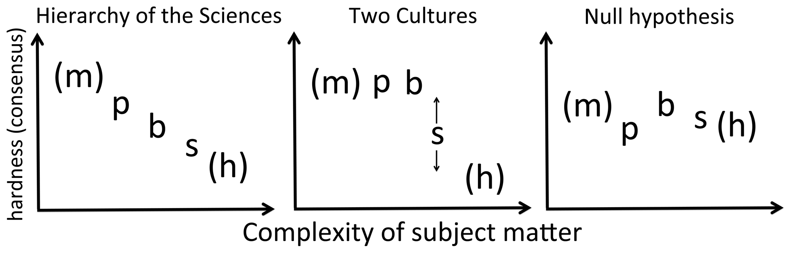
How can we be scientific about scientific demarcation?
cnovel predictions
cnovel predictions
Notes:
Hard = – consensus, for example, ‘‘on the significance of new knowledge and the continuing relevance of old’’
Complexity = complexity of a system is linked to the number of elements involved, their diversity, the number and non-linearity of interactions between them, the cohesiveness of internal versus external relationships
m = mathematics; p = physical sciences; b = biological sc.; s = social sc.; h = humanities).

Slide 7
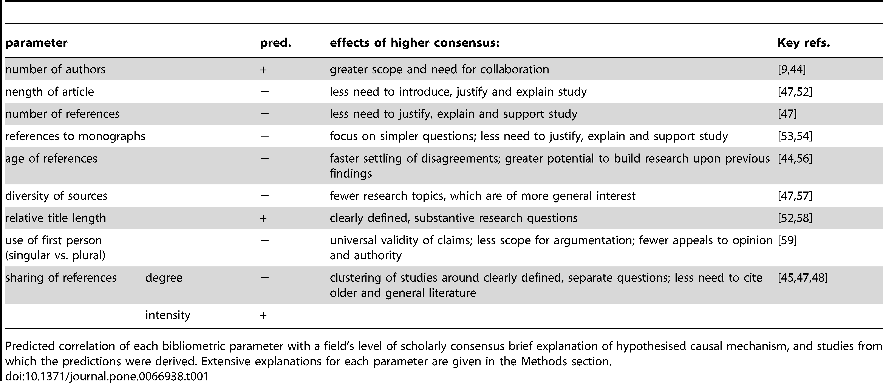

Bibliometric Evidence for a Hierarchy of the Sciences
Fanelli D, Glänzel W (2013) Bibliometric Evidence for a Hierarchy of the Sciences. PLOS ONE 8(6): e66938. https://doi.org/10.1371/journal.pone.0066938
Notes:
So let’s see what scientists actually do, and them compare how archaeology fits in

Slide 8
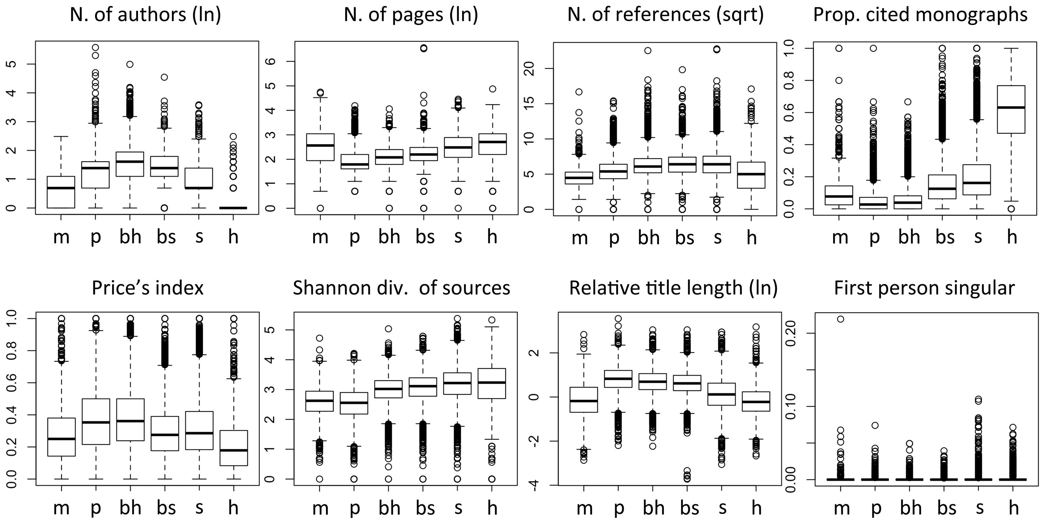
28,477 papers published at the beginning of 2012 in journals that Thomson Reuters’ Essential Science Indicators (ESI)
Notes:
m = mathematics; p = physical sciences (Space Science + Physics + Chemistry); bh = hard-biological disciplines (Molecular Biology + Biology & Biochemistry); bs = soft-biological disciplines (Plant and Animal Sciences + Environment/Ecology); s = social sciences (Psychiatry/Psychology + Economics & Business + Social Sciences, general); h = Humanities. [
29,000 papers published at the beginning of 2012 in journals that Thomson Reuters’ Essential Science Indicators (ESI)
N authors: Research teams are almost by definition built around a consensus on objectives and methods. Moreover, the ability to study a problem with greater accuracy and detail leads to a specialization of roles, making collaboration essential [9]. The hardness of a field, therefore, should be manifest in the size of its research teams. Alternative arguments would suggest that team size is a consequence of funding availability, rather than consensus per se
N pages: When consensus is lower, papers must put greater efforts in describing the background, justify their rationale and approach, back up their claims and extensively discuss their findings [47,52]. Longer introductions, and generally longer papers, should therefore characterize softer research. We measured the total number of pages
Title length: Linguistic analyses of scientific papers noted that the number of substantive words in titles tended to be longer and to correlate with an article’s total length in harder fields [52,58]. This was interpreted as reflecting the greater empirical focus and efficiency of high-consensus fields, but the evidence was deemed too limited to draw firm conclusions. We measured the total number of words, divided by total number of pages.
N refs: For reasons similar to those that make an article longer, references to previous literature should also be more numerous in low-consensus fields [47].
Price: Having noted that some sciences ‘‘metabolize’’ the literature more rapidly, Derek de Solla Price proposed an index, which measures the proportion of cited references published in the five years preceding the citing paper [44]. This index was repeatedly shown to distinguish the social and natural sciences, and is therefore considered the measure of hardness (e.g. [55]).
Shannon: When scholars agree on the relative importance of scientific problems, their efforts will concentrate in specific fields and their findings will be of more general interest, leading to a greater concentration of the relevant literature in few, high-ranking outlets. From harder to softer fields, therefore, we predict a growing diversity of sources of information [47].

Slide 9
Where does archaeology fit?

Slide 10
6,864 archaeology journal articles published during 1998-2018, from Web of Science

Slide 11
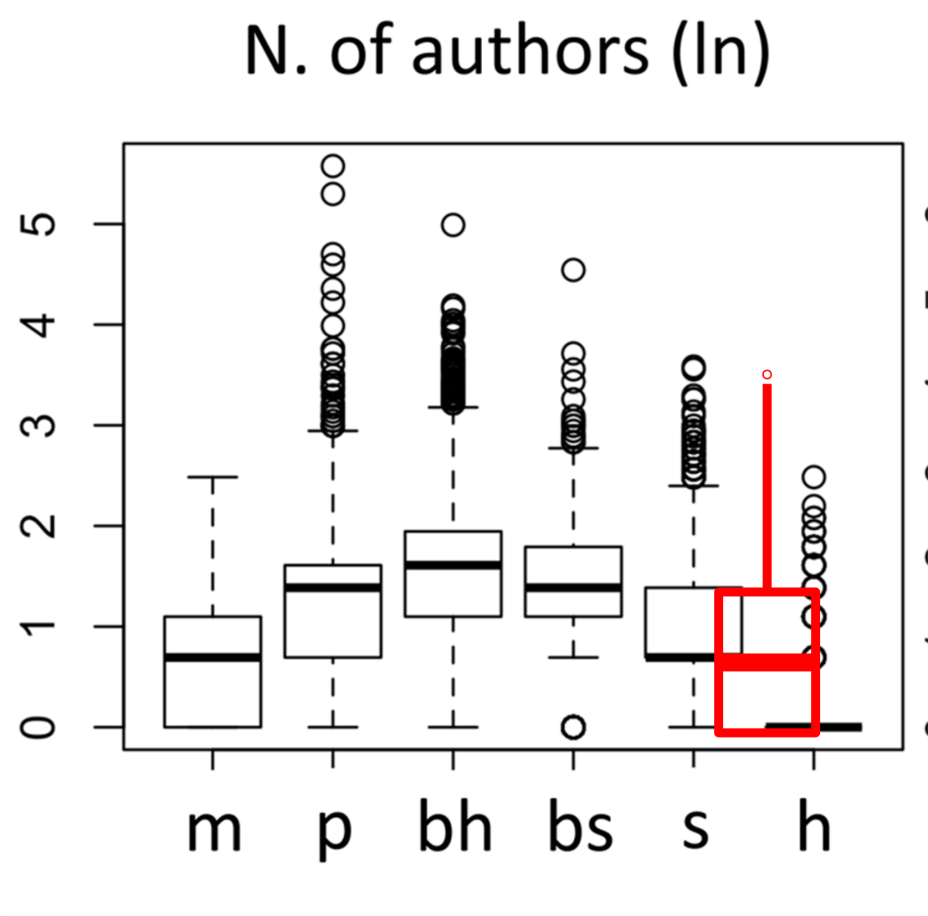
6,864 archaeology journal articles published during 1998-2018, from Web of Science

Slide 12
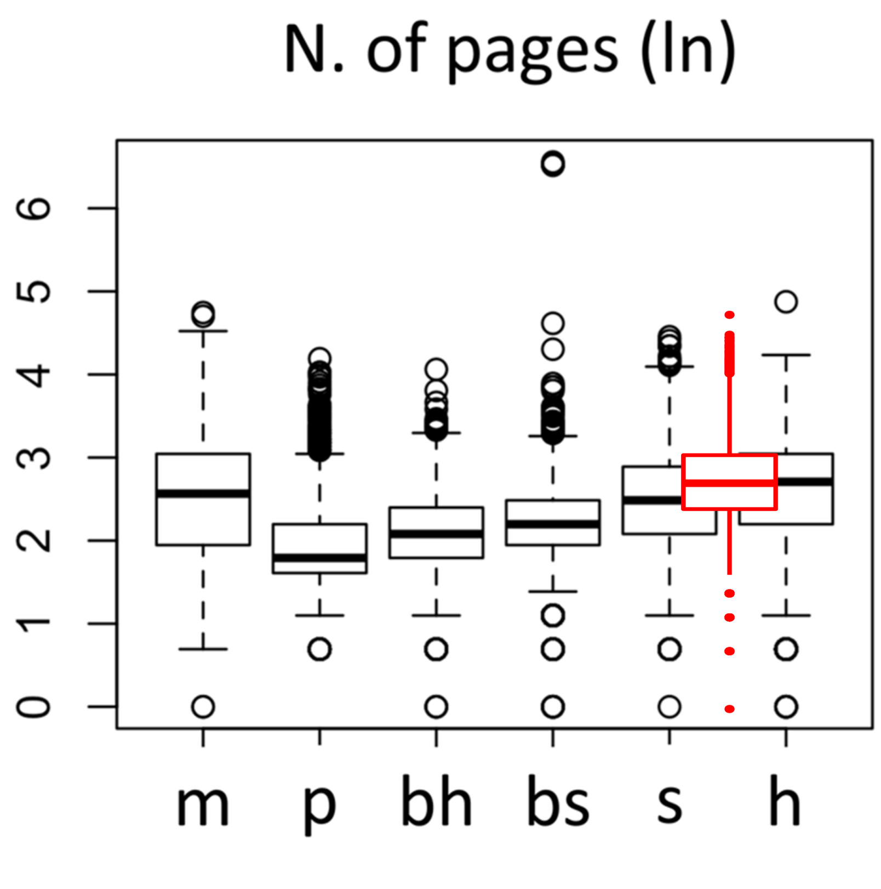
6,864 archaeology journal articles published during 1998-2018, from Web of Science

Slide 13
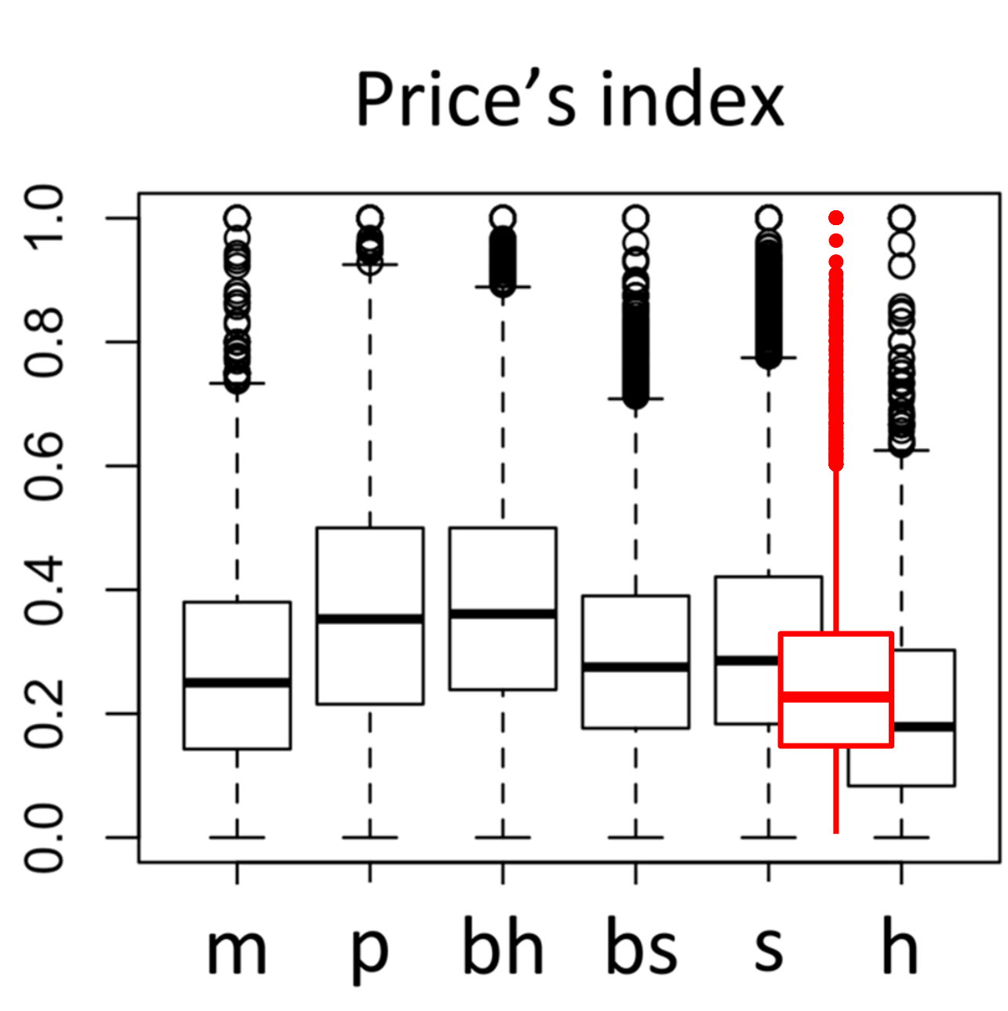
6,864 archaeology journal articles published during 1998-2018, from Web of Science

Slide 14
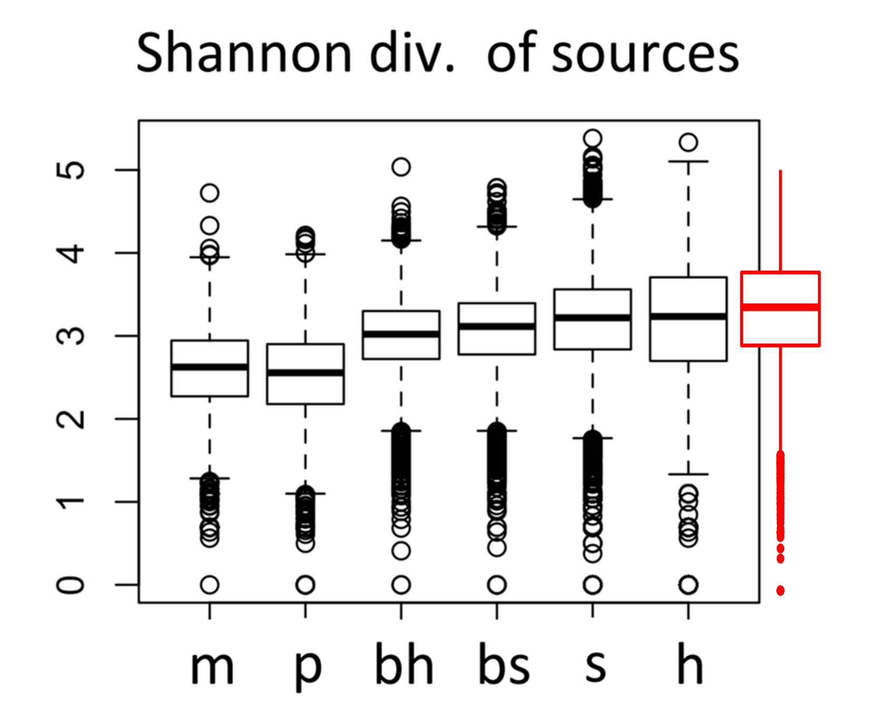
6,864 archaeology journal articles published during 1998-2018, from Web of Science

Slide 15
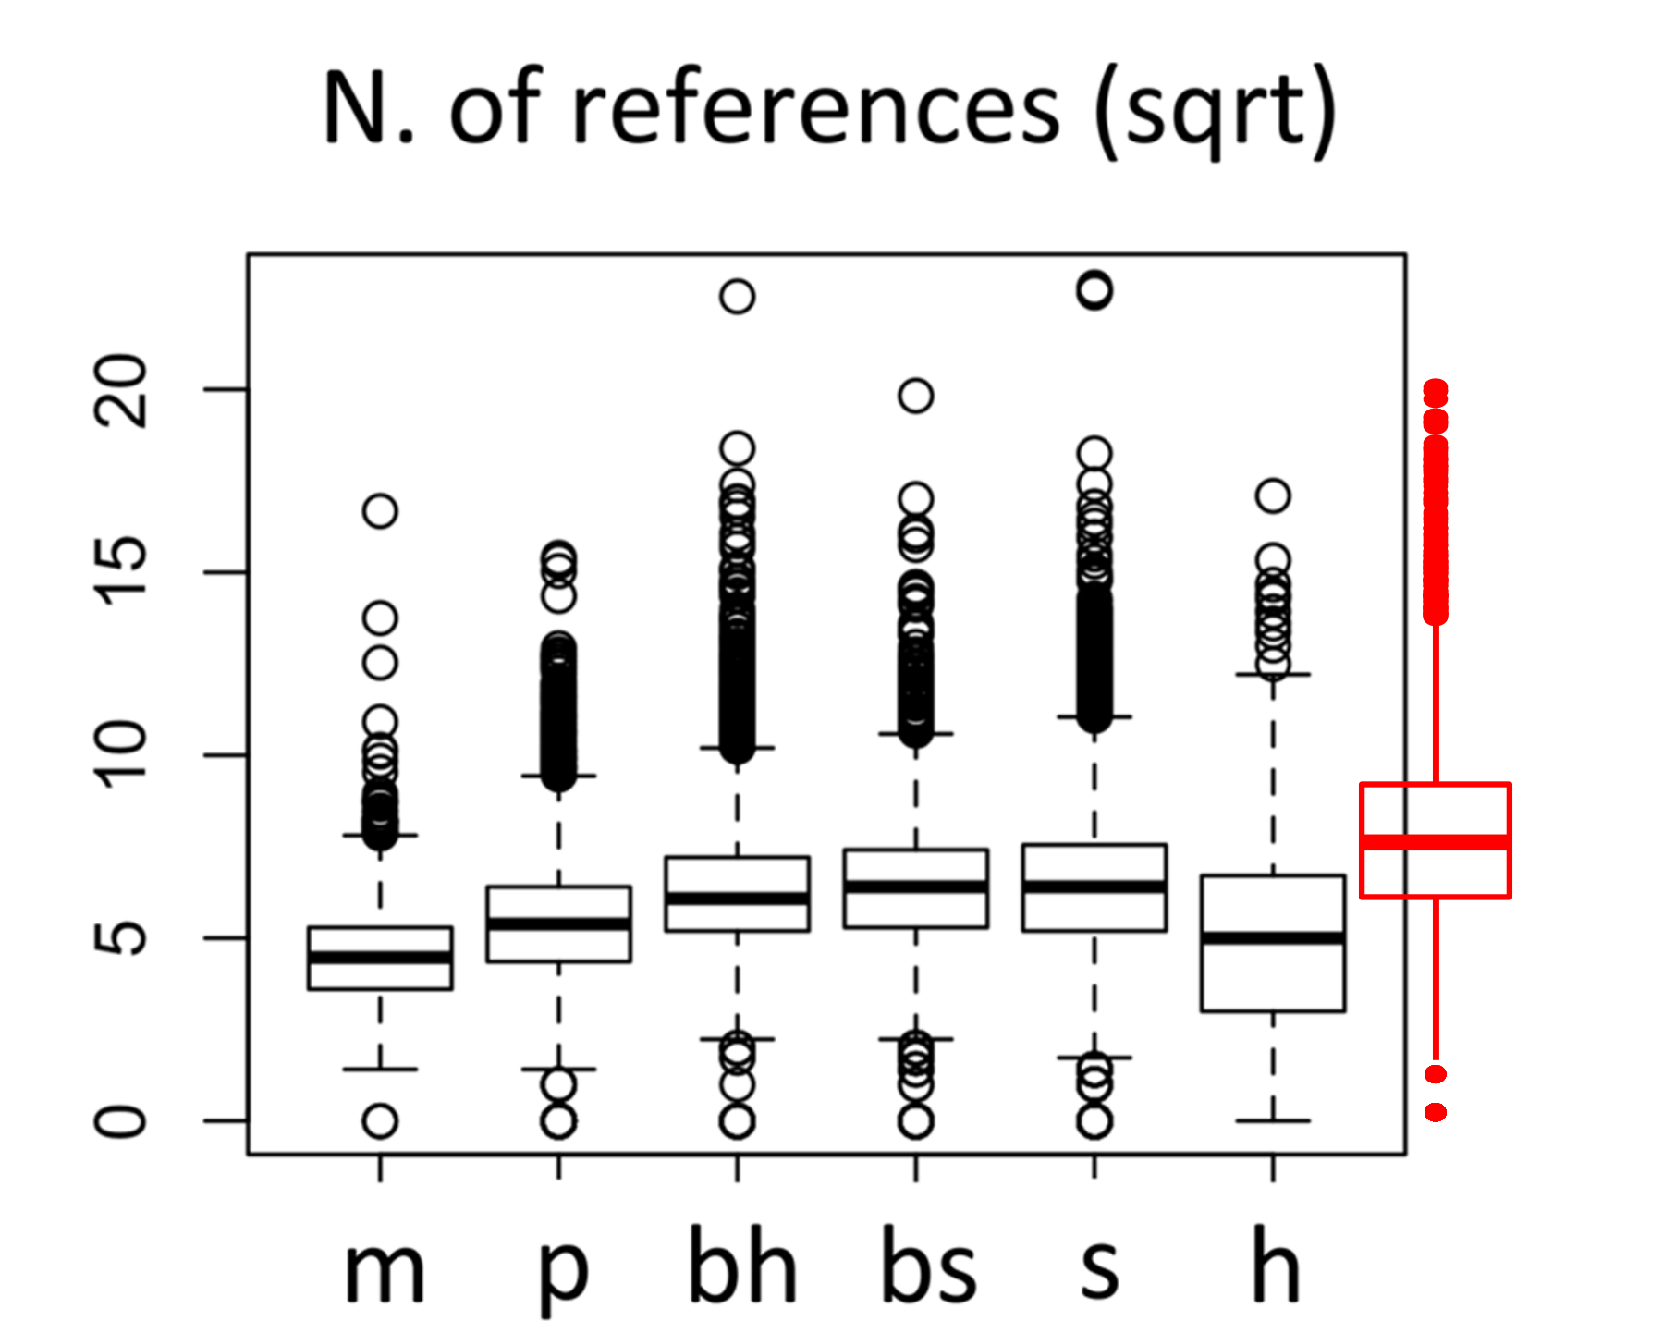
6,864 archaeology journal articles published during 1998-2018, from Web of Science

Slide 16
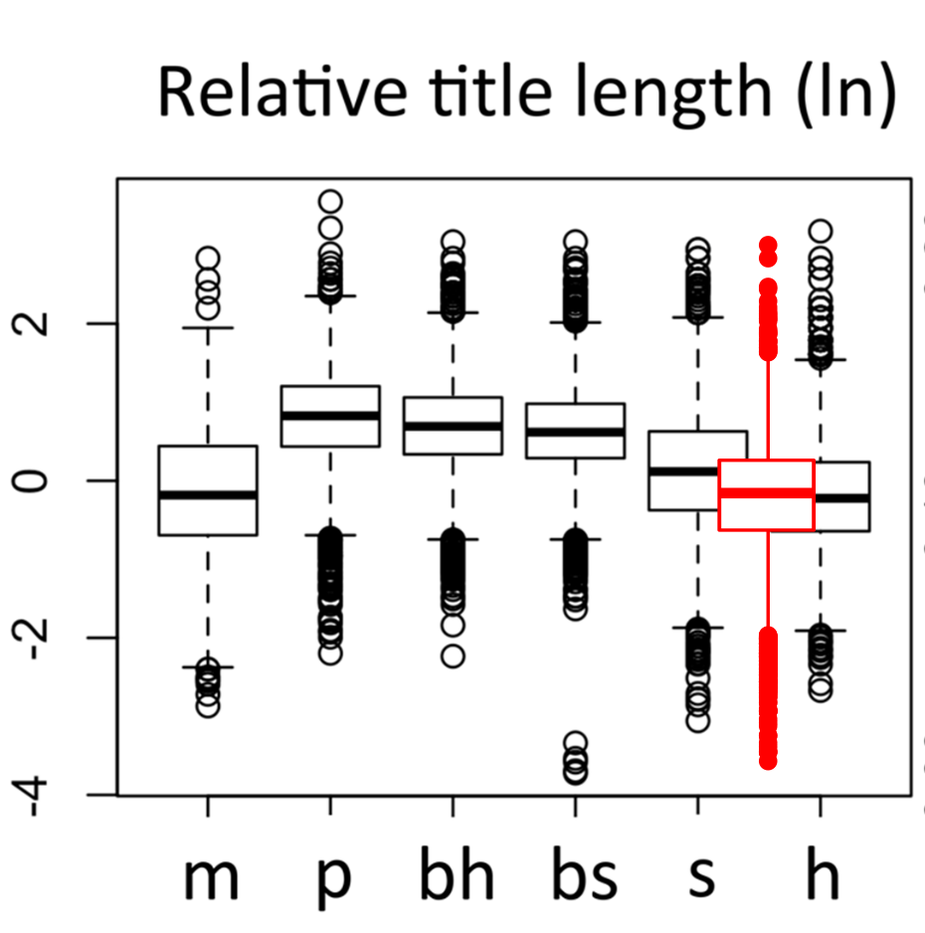
6,864 archaeology journal articles published during 1998-2018, from Web of Science

Slide 17
Bibliometric analysis indicates that archaeology is not much like a science.
By most measures it is between social science and humanities
And by some measures, less like a science than the humanities 🤔
Notes:
Because we work in isolated groups, and have a strong culture of privacy and individual data ownership. In short, we have a cultural attributes that stop us from being a science

Slide 18
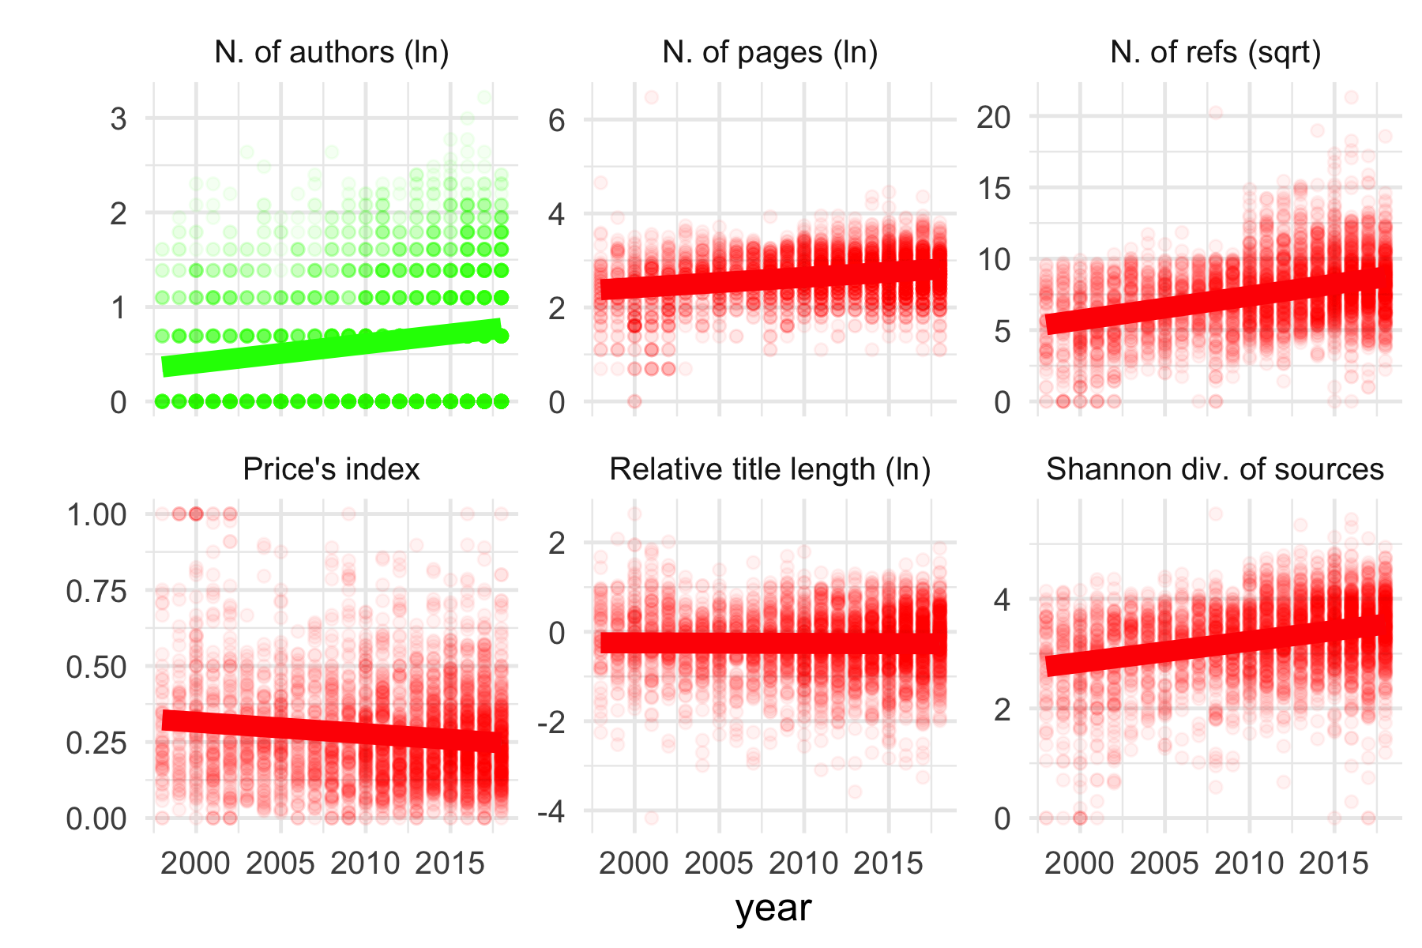
How is archaeology changing over time?

Slide 19
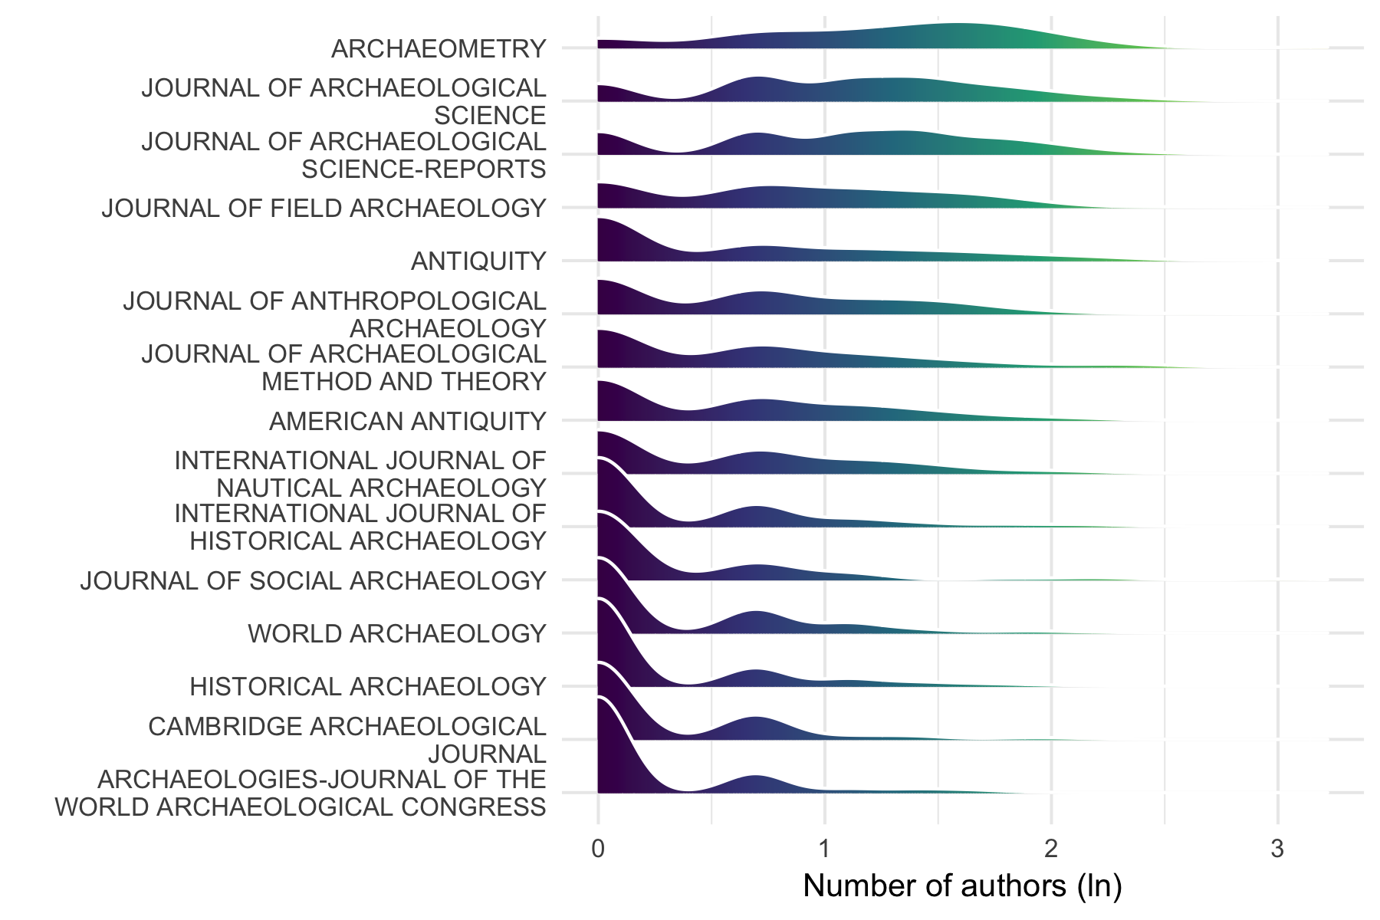
6,864 archaeology journal articles published during 1998-2018, from Web of Science

Slide 20
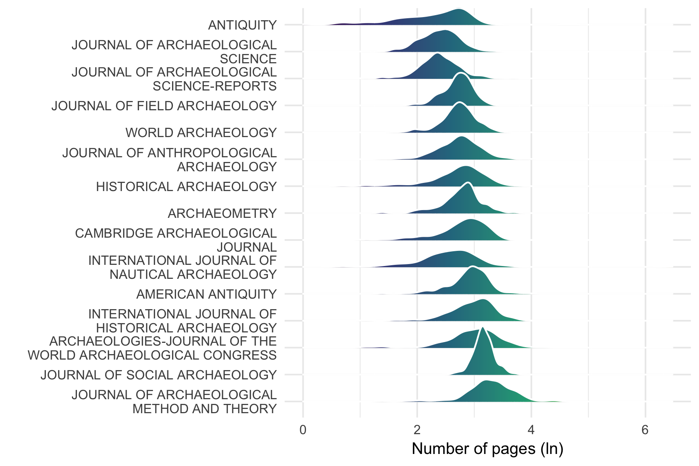
6,864 archaeology journal articles published during 1998-2018, from Web of Science

Slide 21
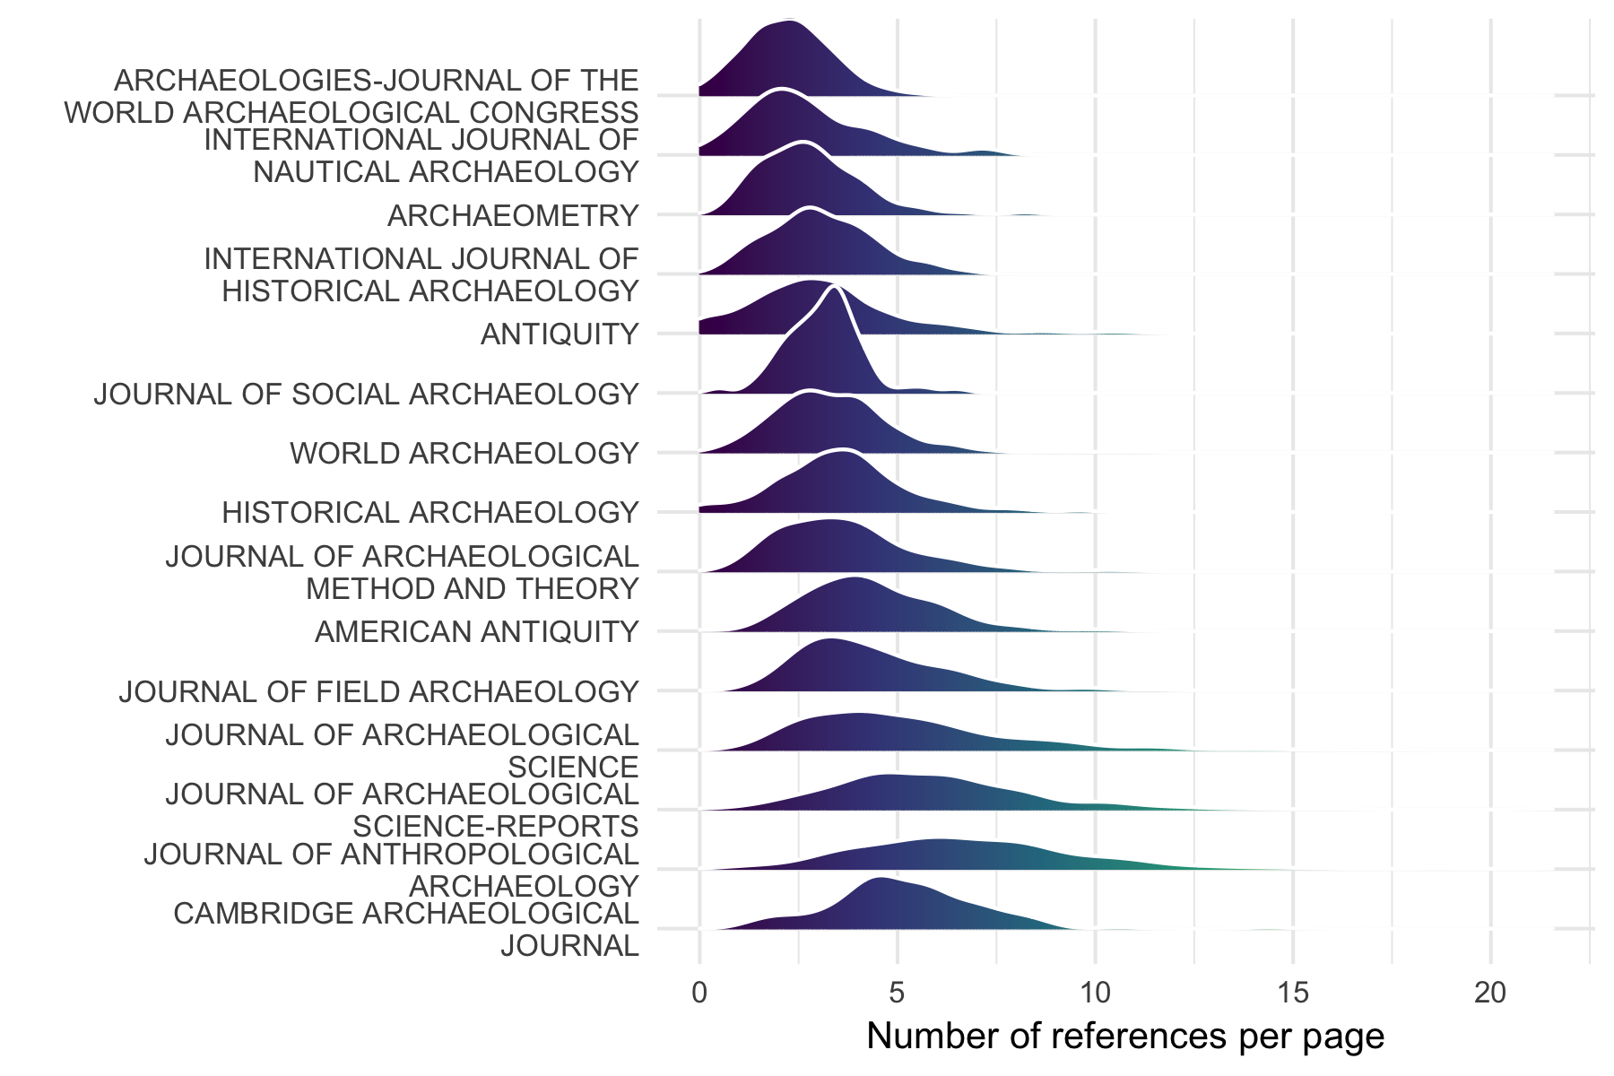
6,864 archaeology journal articles published during 1998-2018, from Web of Science

Slide 22
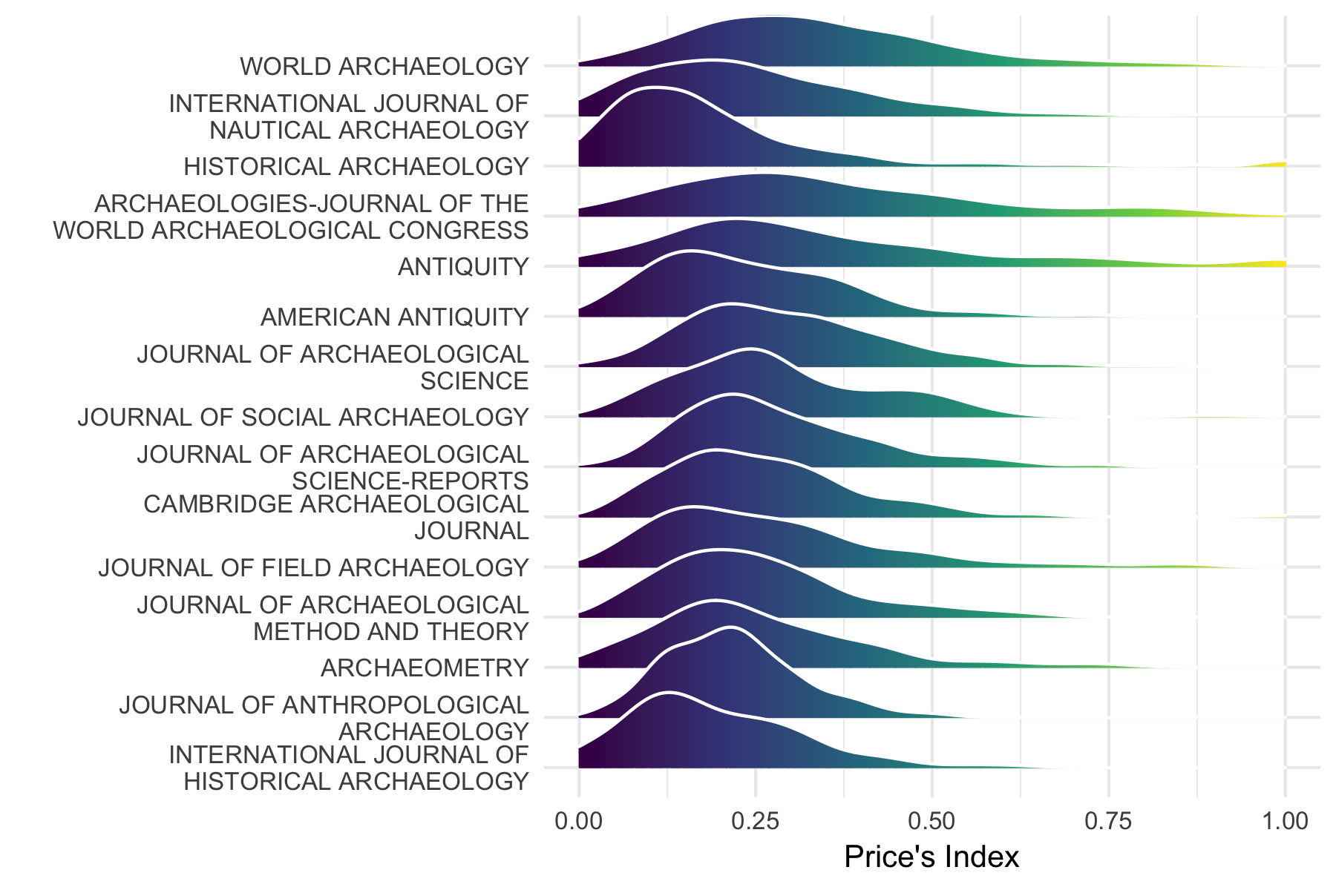
6,864 archaeology journal articles published during 1998-2018, from Web of Science

Slide 23
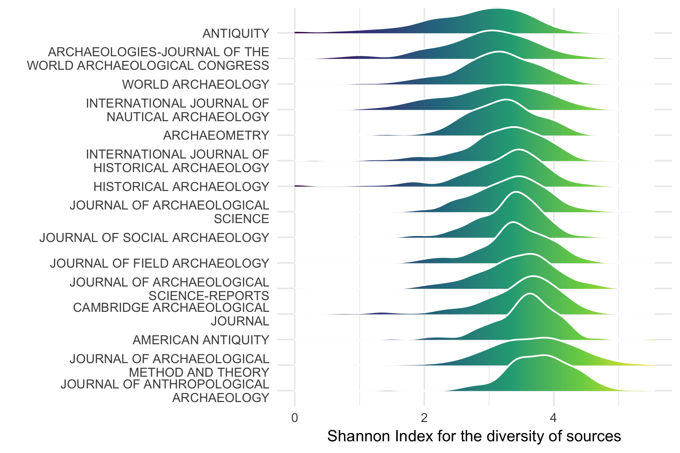
6,864 archaeology journal articles published during 1998-2018, from Web of Science

Slide 24
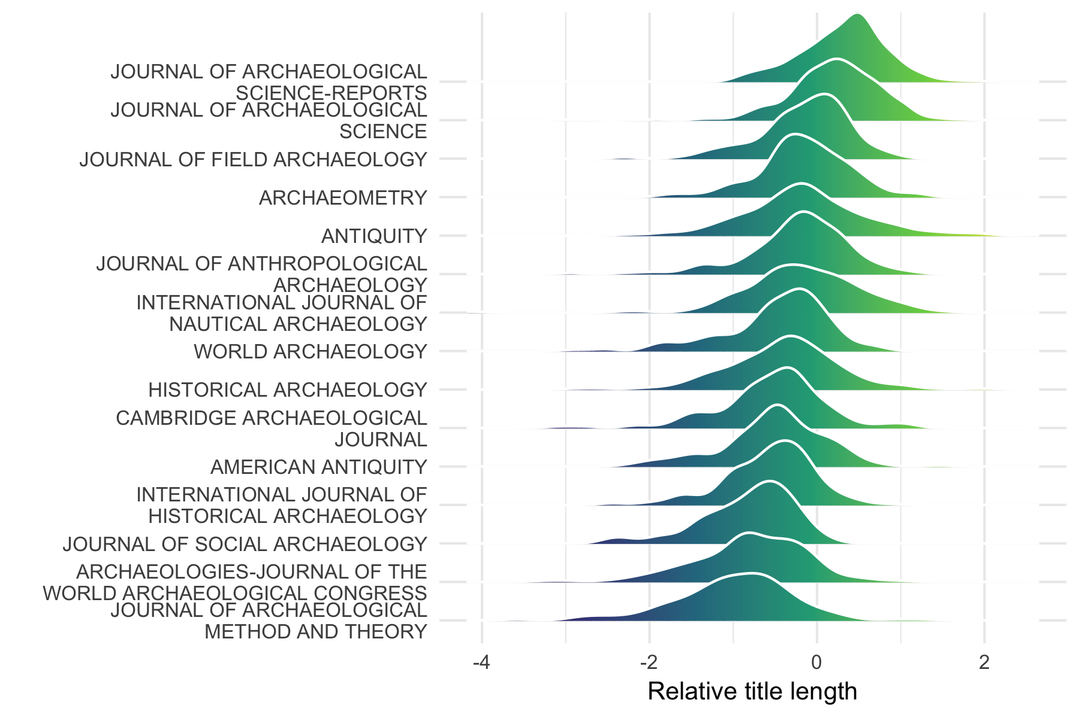
6,864 archaeology journal articles published during 1998-2018, from Web of Science

Slide 25
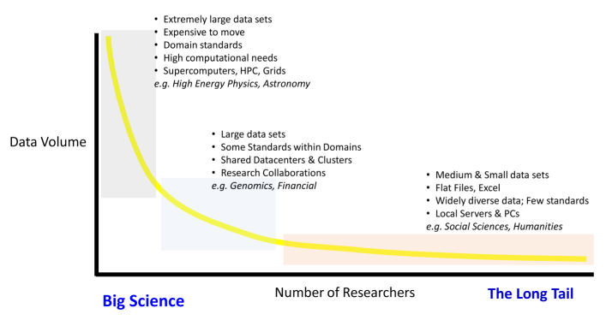
Archaeology is not really a hard science.
Bigness of data
Big data may never be a big part of archaeology.
So how can we expect to benefit from it?
Notes:
Where are we on this plot, and given that location, what can we expect from big data that will be good for archaeology?

Slide 26
Tool-driven change

Slide 27
What’s the cause of revolutions in science?
Idea-driven (Kuhn 1962)
“normal science” punctuated by “revolutions”
These create a completely different view / way of doing things
Tool-driven (Galison 1997)
Instrumentation is caught up in various power/knowledge relationships
Major changes in science occur with technological changes
Notes:
Kuhn: replacement of the Ptolemaic system by the Copernican system, and Newtonian dynamics by the new Einsteinian dynamics.
Galison: experimental particle physics

Slide 28
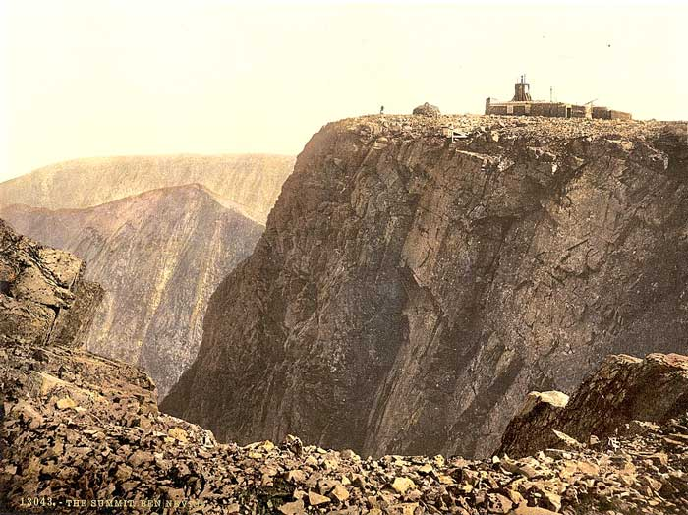
http://ben-nevis.com/information/history/observatory/observatory.php
Notes:
In the late 19th C physicists literally went into the clouds to observe atmospheric effects, cloud formation and study weather patterns. Here is the Ben Nevis Observatory in Scotland, where Charles Wilson studied cloud formation.

Slide 29
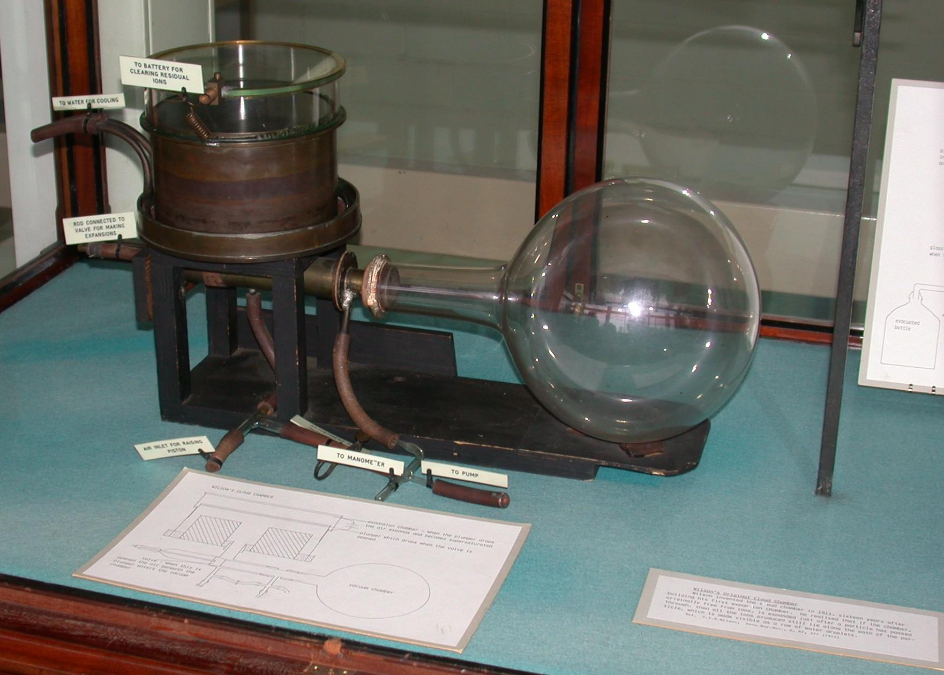
http://www-outreach.phy.cam.ac.uk/camphy/museum/area2/images/cabinet1_2.jpg
Notes:
Here’s one of the first cloud chambers, and here’s a photograph of some of the trails that Wilson observed, showing alpha and beta radiation from radium. These instruments were very popular from the 1920s to the 1950s, and central to the study of radioactivity and discovery of many nuclear particles, with Wilson receiving a Nobel Prize for it in 1927.
He discovered that if the air in the chamber was saturated, it was possible to see the path of nuclear particles emitted by radioactive substances. This is kind of like a microscope into nuclear physics, and became very popular.

Slide 30
Physics and Archaeology are distant, but what about about tool-driven changes in a softer science, like Ecology?
Notes:
@Touchon_McCoy_2016 investigated evaluated changes in statistical methods used by ecologists as a potential area of tool-driven change. They searched nearly 20,000 published articles in ecology published between 1990 and 2013. They found that there has been a rise in complex and computationally intensive statistical techniques such as mixed effects models and Bayesian statistics and a decline in reliance on approaches such as ANOVA or t-tests. Crucially, they found that ecologists have shifted away from software tools such as SAS and SPSS to the open source program R.
@Touchon_McCoy_2016 identify four factors relating to technological change that might explain the changes they observed in the use of statistics in ecology. First, they note that automated data loggers, GPS trackers, remote sensing, and crowd sourcing have greatly increased rate at which ecologists collect data. Second, increases in desktop and cluster computing power has made complex analytical processes faster and more convenient to compute. Third, the development of free, open source and easily extensible software for data analysis and visualisation, such as R, allows new methods to spread quickly via online fora and social media. Fourth, the publication of several books and papers that have strongly influenced the way many ecologists think about data analysis, such as @burnham2003model's book on model selection and inference.

Slide 31
Touchon, J. C., and M. W. McCoy. 2016. The mismatch between current statistical practice and doctoral training in ecology. Ecosphere 7:e01394.
Evaluated changes in statistics used by ecologists by searching 20,000 published articles in ecology from 1990 to 2013
A rise in complex and computationally intensive statistical techniques such as mixed effects models and Bayesian statistics and a decline in reliance on approaches such as ANOVA or t-tests.
Notes:
@Touchon_McCoy_2016 investigated evaluated changes in statistical methods used by ecologists as a potential area of tool-driven change. They searched nearly 20,000 published articles in ecology published between 1990 and 2013. They found that there has been a rise in complex and computationally intensive statistical techniques such as mixed effects models and Bayesian statistics and a decline in reliance on approaches such as ANOVA or t-tests. Crucially, they found that ecologists have shifted away from software tools such as SAS and SPSS to the open source program R.
@Touchon_McCoy_2016 identify four factors relating to technological change that might explain the changes they observed in the use of statistics in ecology. First, they note that automated data loggers, GPS trackers, remote sensing, and crowd sourcing have greatly increased rate at which ecologists collect data. Second, increases in desktop and cluster computing power has made complex analytical processes faster and more convenient to compute. Third, the development of free, open source and easily extensible software for data analysis and visualisation, such as R, allows new methods to spread quickly via online fora and social media. Fourth, the publication of several books and papers that have strongly influenced the way many ecologists think about data analysis, such as @burnham2003model's book on model selection and inference.

Slide 32
Touchon and McCoy. 2016. explain the changes they observed in the use of statistics in ecology as a result of:
Data loggers, GPS trackers, remote sensing, and crowd sourcing, greatly increasing the rate of data collection
Increases in desktop and cluster computing power making complex analytical processes faster and more convenient
Free, open source and easily extensible software for data analysis and visualisation, such as R, allows new methods to spread quickly via online fora and social media.
Books and papers that have strongly influenced the way many ecologists think about data analysis
Notes:
@Touchon_McCoy_2016 investigated evaluated changes in statistical methods used by ecologists as a potential area of tool-driven change. They searched nearly 20,000 published articles in ecology published between 1990 and 2013. They found that there has been a rise in complex and computationally intensive statistical techniques such as mixed effects models and Bayesian statistics and a decline in reliance on approaches such as ANOVA or t-tests. Crucially, they found that ecologists have shifted away from software tools such as SAS and SPSS to the open source program R.
@Touchon_McCoy_2016 identify four factors relating to technological change that might explain the changes they observed in the use of statistics in ecology. First, they note that automated data loggers, GPS trackers, remote sensing, and crowd sourcing have greatly increased rate at which ecologists collect data. Second, increases in desktop and cluster computing power has made complex analytical processes faster and more convenient to compute. Third, the development of free, open source and easily extensible software for data analysis and visualisation, such as R, allows new methods to spread quickly via online fora and social media. Fourth, the publication of several books and papers that have strongly influenced the way many ecologists think about data analysis, such as @burnham2003model's book on model selection and inference.

Slide 33
Touchon and McCoy. 2016. explain the changes they observed in the use of statistics in ecology as a result of:
Data loggers, GPS trackers, remote sensing, and crowd sourcing, greatly increasing the rate of data collection
Increases in desktop and cluster computing power making complex analytical processes faster and more convenient
Free, open source and easily extensible software for data analysis and visualisation, such as R, allows new methods to spread quickly via online fora and social media.
Books and papers that have strongly influenced the way many ecologists think about data analysis
Notes:
@Touchon_McCoy_2016 investigated evaluated changes in statistical methods used by ecologists as a potential area of tool-driven change. They searched nearly 20,000 published articles in ecology published between 1990 and 2013. They found that there has been a rise in complex and computationally intensive statistical techniques such as mixed effects models and Bayesian statistics and a decline in reliance on approaches such as ANOVA or t-tests. Crucially, they found that ecologists have shifted away from software tools such as SAS and SPSS to the open source program R.
@Touchon_McCoy_2016 identify four factors relating to technological change that might explain the changes they observed in the use of statistics in ecology. First, they note that automated data loggers, GPS trackers, remote sensing, and crowd sourcing have greatly increased rate at which ecologists collect data. Second, increases in desktop and cluster computing power has made complex analytical processes faster and more convenient to compute. Third, the development of free, open source and easily extensible software for data analysis and visualisation, such as R, allows new methods to spread quickly via online fora and social media. Fourth, the publication of several books and papers that have strongly influenced the way many ecologists think about data analysis, such as @burnham2003model's book on model selection and inference.

Slide 34

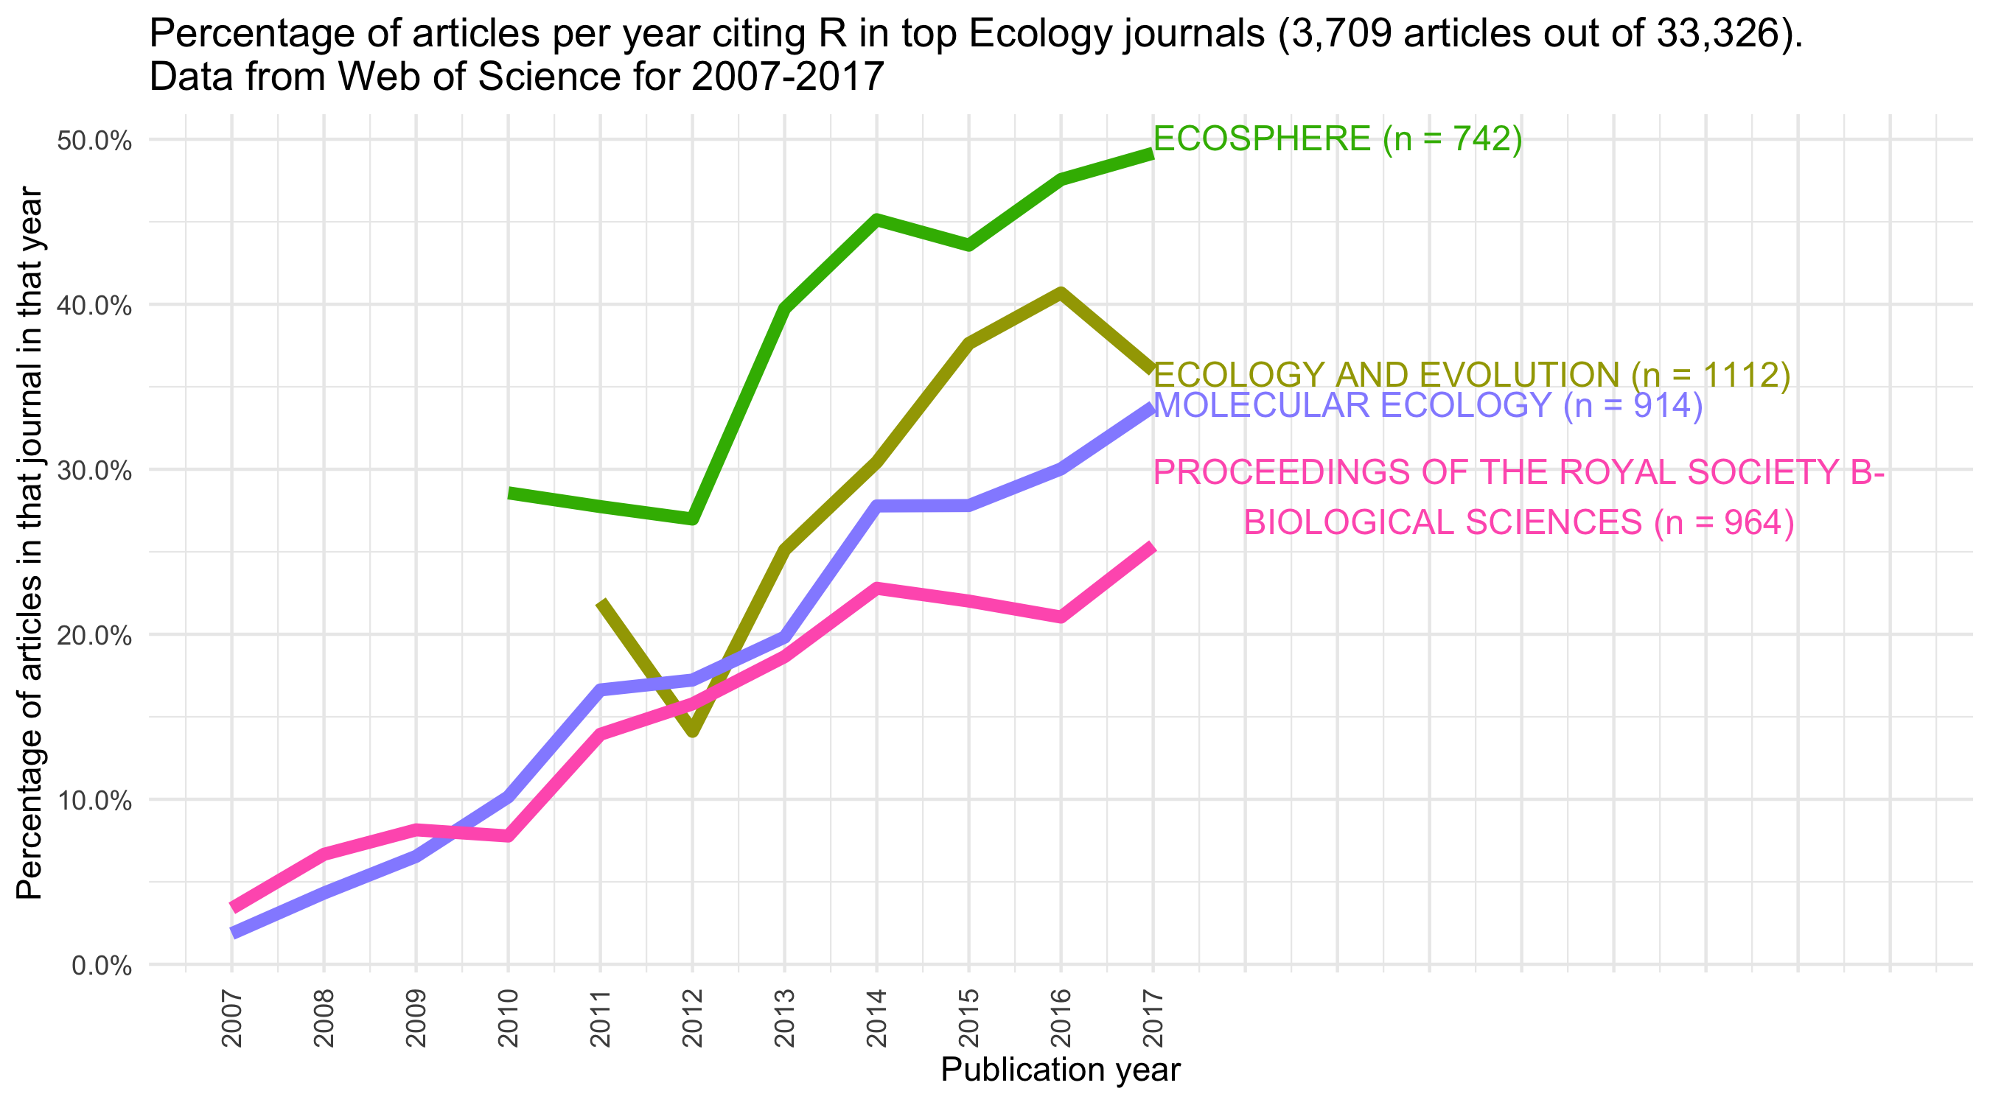
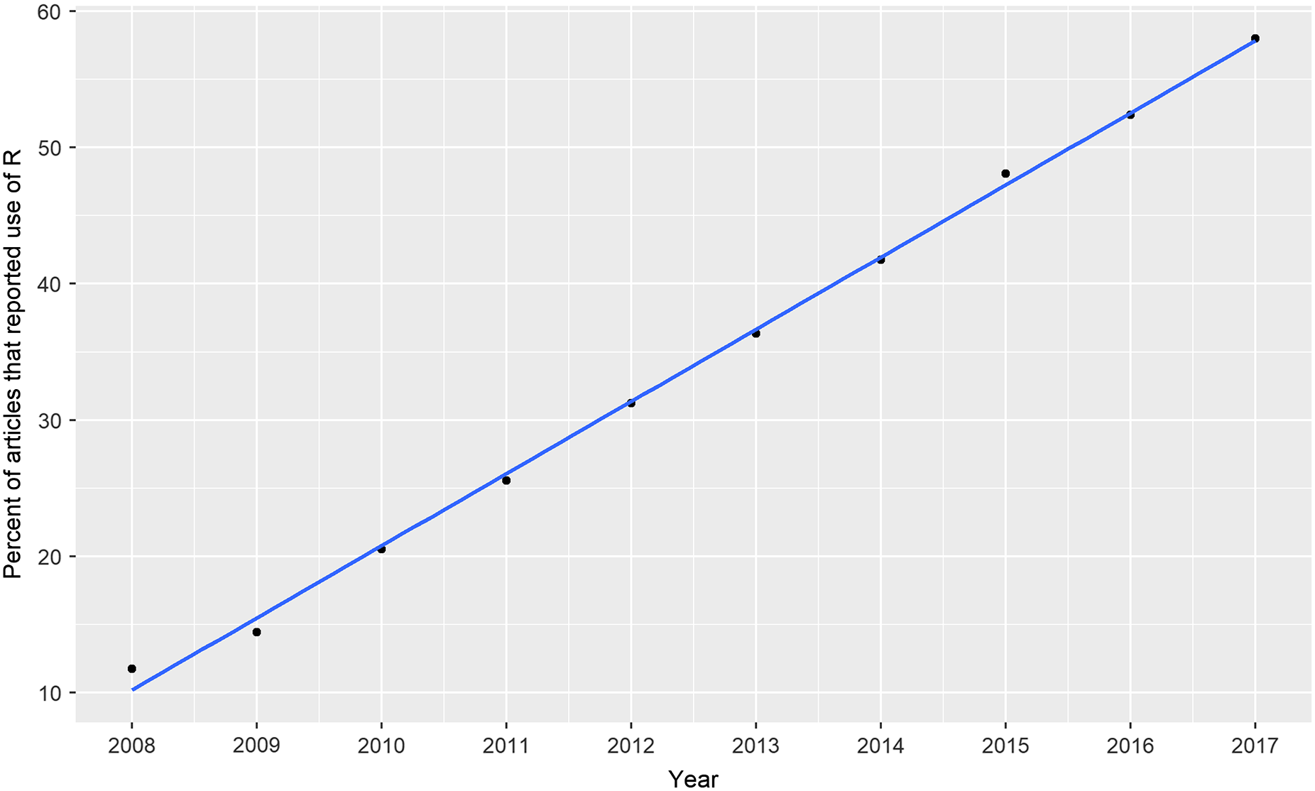
R is a free and open source programming language that is widely used in many research communities
Lai et al. 2019: 60 k articles in 30 main ecology journals from 2008 to 2017
Notes:
We used the 'Cited Reference Search' function provided by the Web of Science online scientific citation indexing service to find journal articles citing R. Although R has been available since the late 1990s [@Thieme_2018], a recommended format for citing the software did not appear until 2004, with the author given as "R Development Core Team". This recommended format for citing the software changed slightly in 2012 when the author was updated to "R Core Team". We searched the Web of Science using '"R DEV COR TEAM" OR "R CORE" OR "R CORE TEAM" OR "R DEVELOPMENT CORE TEAM"' in the CITED AUTHOR field of the Web of Science database. We sorted the results by frequency of citations, and selected the first 1000 items (the maximum allowed by the Web of Science service). These 1000 items represent variations on the recommended format for citing R. We found citations of R in the reference lists of `r prettyNum(how_many_articles_in_top_journals_for_cran_cites, ",")` English-languge articles indexed by the Web of Science in the research area of 'Environmental Sciences Ecology'. We then downloaded the bibliographic data and reference lists for each of these articles.
Figure \@ref(fig:ecology-articles-citing-r-plot) shows the percentage of articles citing R in each of several of the top ecology journals (as defined by how often their articles are cited). We restrict the start of the observation period to 2007 for convenience so we have a ten year study period. The plot shows that the percentage of articles citing R has increased from less than ten percent in all journals in the late 2000s, to more than 30% in _Ecosphere_, _Ecology and Evolution_, and _Molecular Ecology_ after 2012. We might not call this a Kuhnian paradigm shift, but it does show a substantial change in the tools of the discipline, supporting claims for a Galisonian tool-driven change in ecology similar to the changes described by @Touchon_McCoy_2016.

Slide 35
Perhaps we can see a trace of a tool-driven change related to Big Data in Ecology
How about archaeology?
Notes:
@Touchon_McCoy_2016 investigated evaluated changes in statistical methods used by ecologists as a potential area of tool-driven change. They searched nearly 20,000 published articles in ecology published between 1990 and 2013. They found that there has been a rise in complex and computationally intensive statistical techniques such as mixed effects models and Bayesian statistics and a decline in reliance on approaches such as ANOVA or t-tests. Crucially, they found that ecologists have shifted away from software tools such as SAS and SPSS to the open source program R.
@Touchon_McCoy_2016 identify four factors relating to technological change that might explain the changes they observed in the use of statistics in ecology. First, they note that automated data loggers, GPS trackers, remote sensing, and crowd sourcing have greatly increased rate at which ecologists collect data. Second, increases in desktop and cluster computing power has made complex analytical processes faster and more convenient to compute. Third, the development of free, open source and easily extensible software for data analysis and visualisation, such as R, allows new methods to spread quickly via online fora and social media. Fourth, the publication of several books and papers that have strongly influenced the way many ecologists think about data analysis, such as @burnham2003model's book on model selection and inference.

Slide 36
Tool-driven change in archaeology

Slide 37
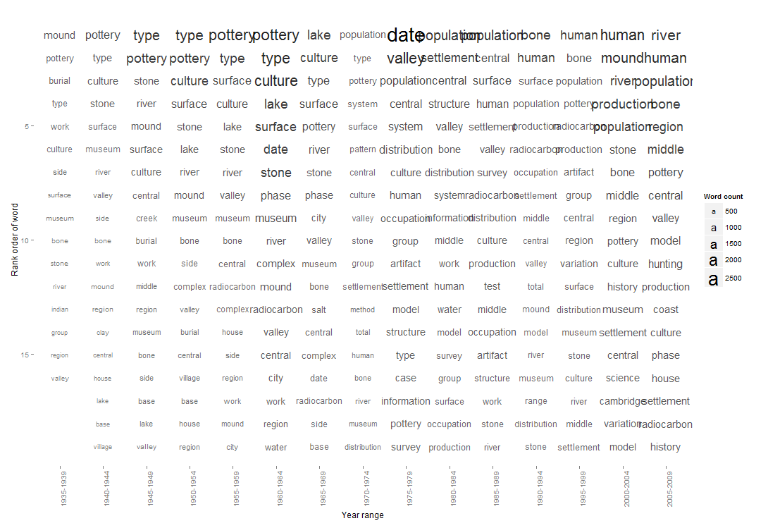
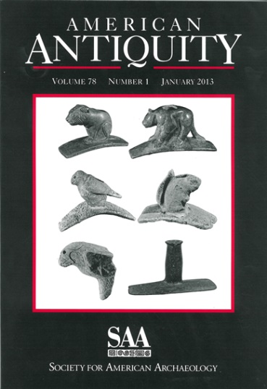
Looking back, we see a turn from typological analyses of pottery to work on population-level behaviors and settlement patterns in archaeology
Notes:
Here is an analysis of the full-text of all the articles in American Antiquity, the most popular words of each five year interval from 1935-2009
We see a turn from typological analyses of pottery to work on population-level behaviors and settlement patterns in archaeology. We see dating as a big deal. So this is a good example of a technology that has changed us, but what about some analogs of this shift from image to logic, from analog to digital? Where are the ‘reading machines’ that Galison found to be so transformative in physics?

Slide 38
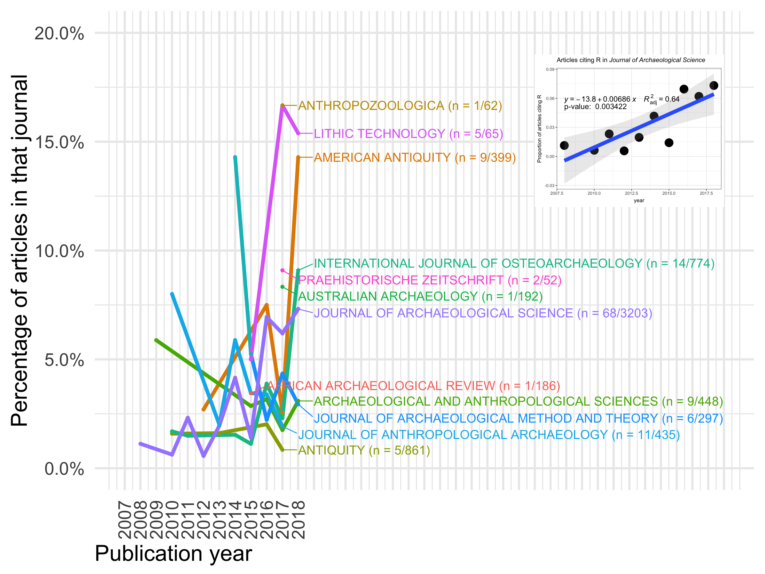
Is a turn towards using R on the horizon?

Slide 39
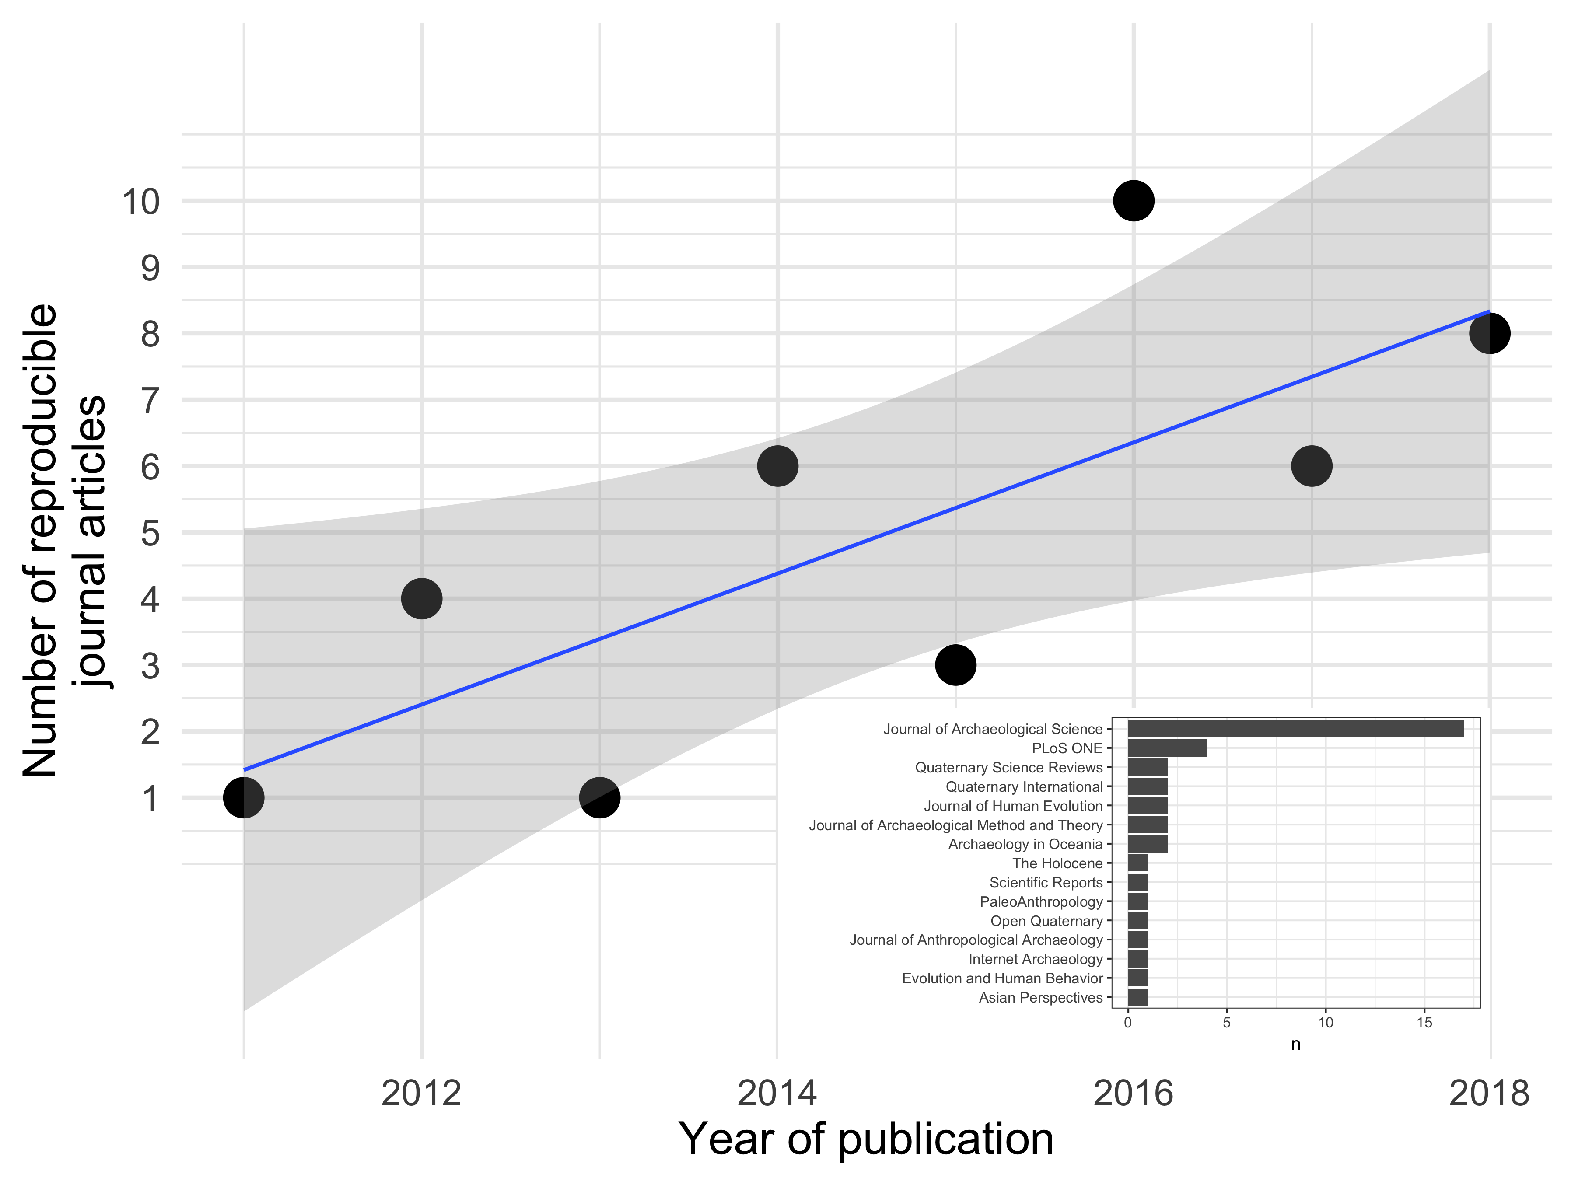
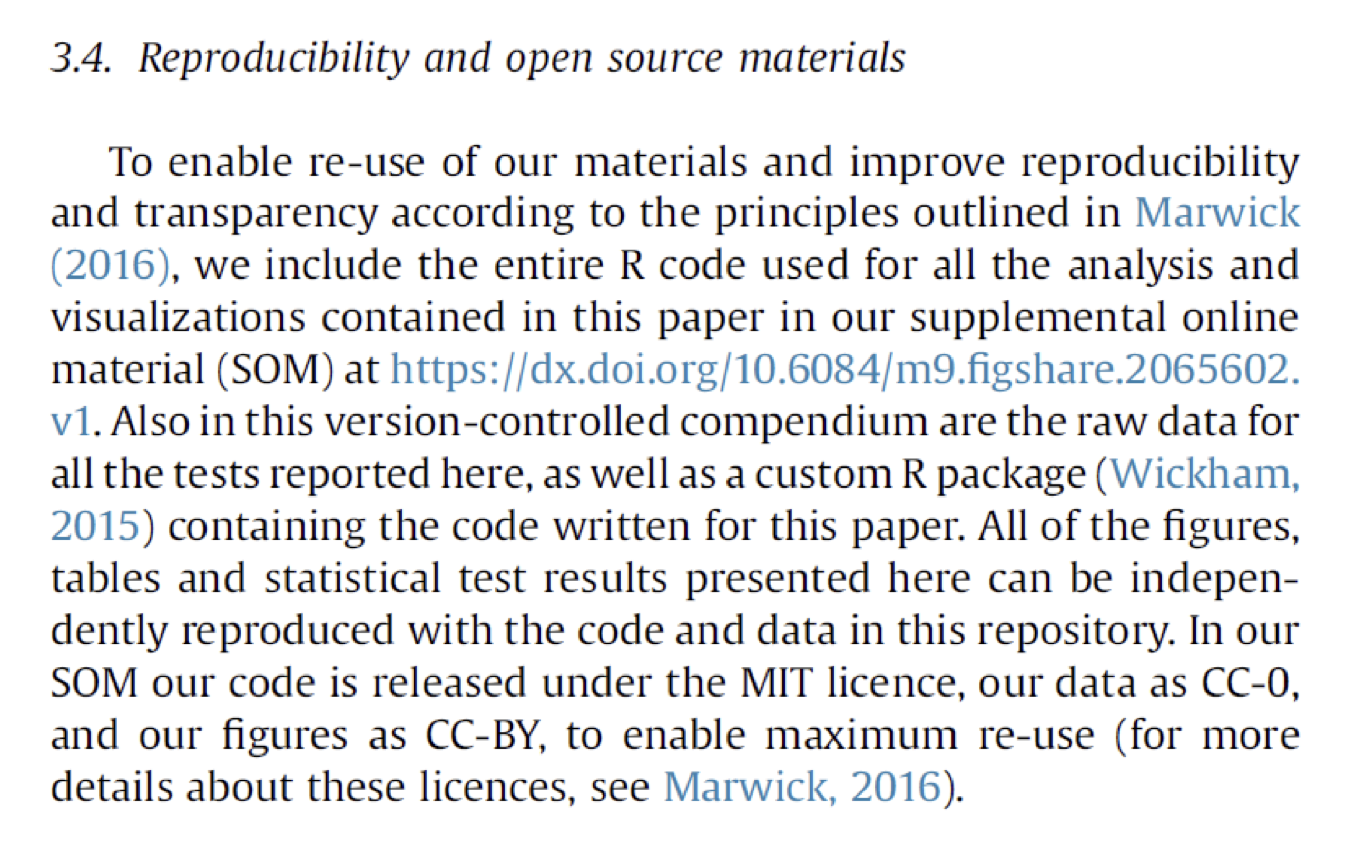
Is a turn towards using R on the horizon?

Slide 40
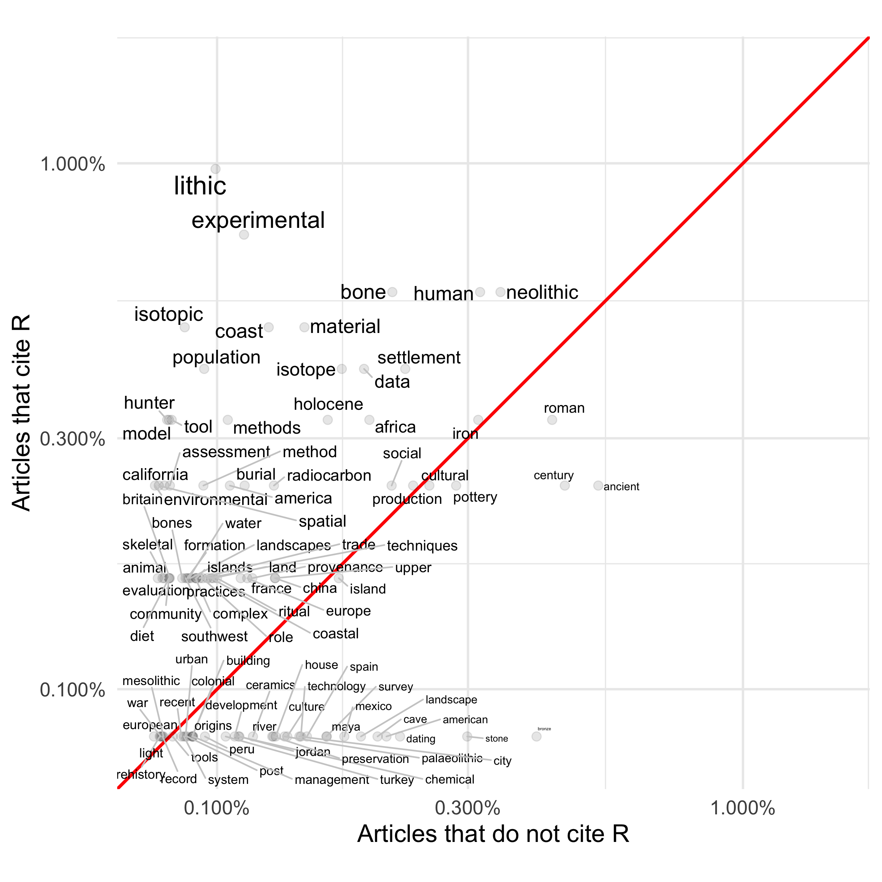
How are archaeologists using R?

Slide 41
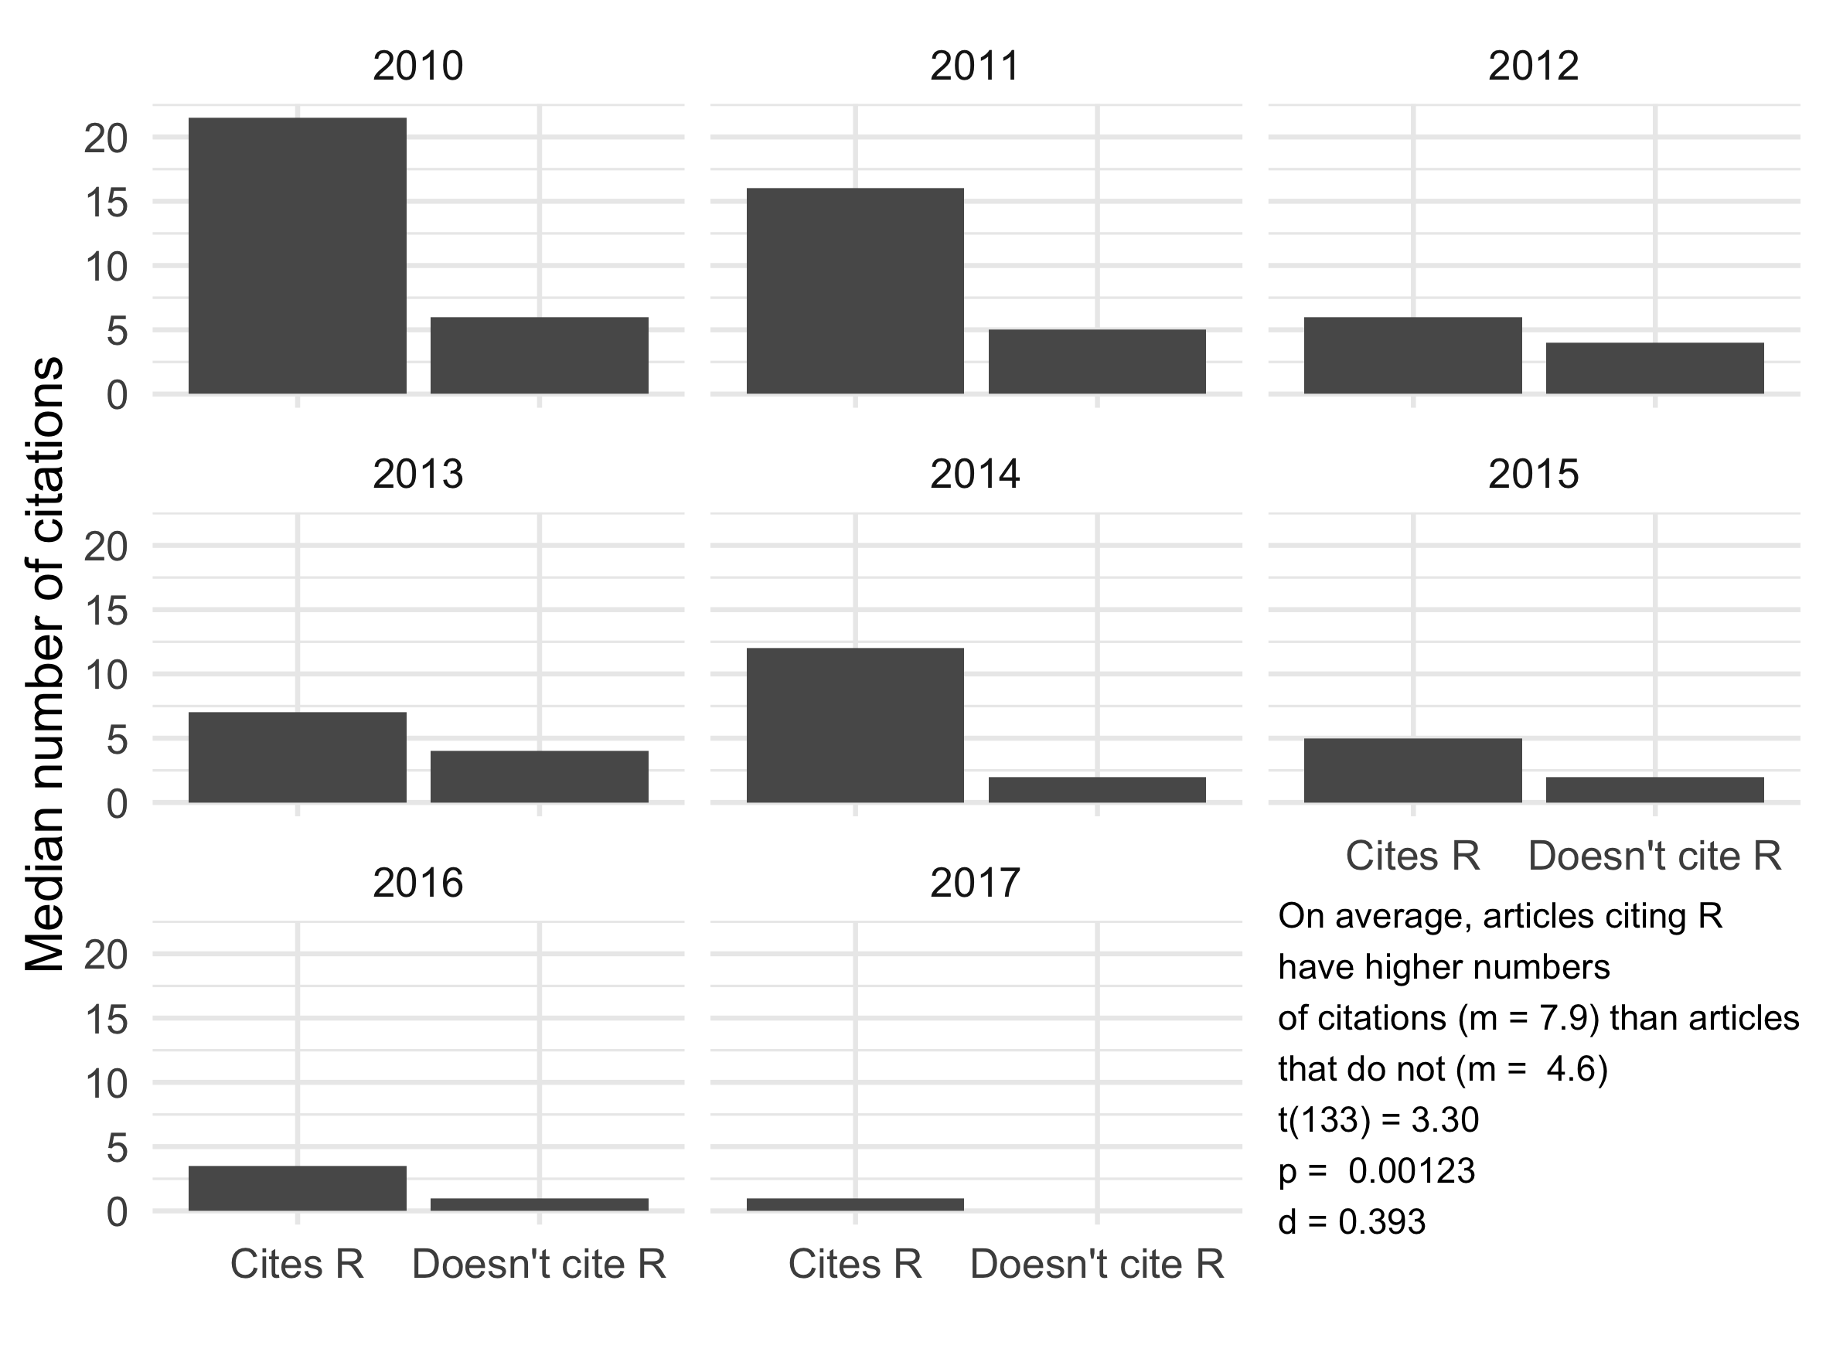
Research done using R has more impact

Slide 42
Archaeology may be at the start of a tool-driven change, analogous to what we’ve seen in Ecology.
But does Big Data have any potential directly?

Slide 43
The disruptiveness of Big Data in Archaeology

Slide 44
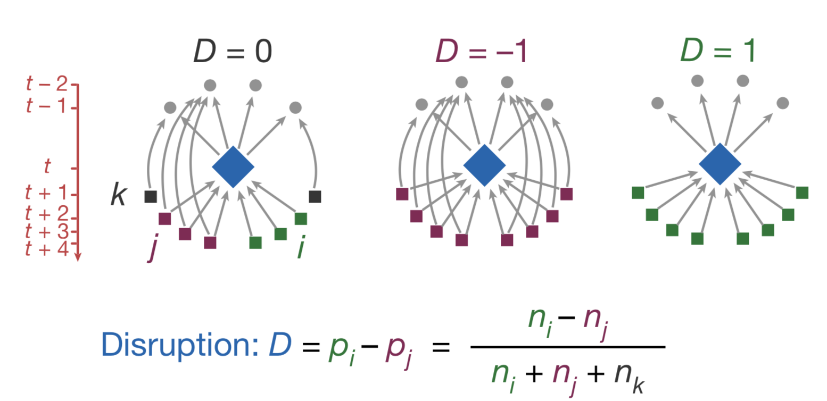
A disruption index for identifying consolidating and destabilizing work
Funk, R and J. Owen-Smith (2017) A Dynamic Network Measure of Technological Change. Management Science 63(3): 791-817

Slide 45
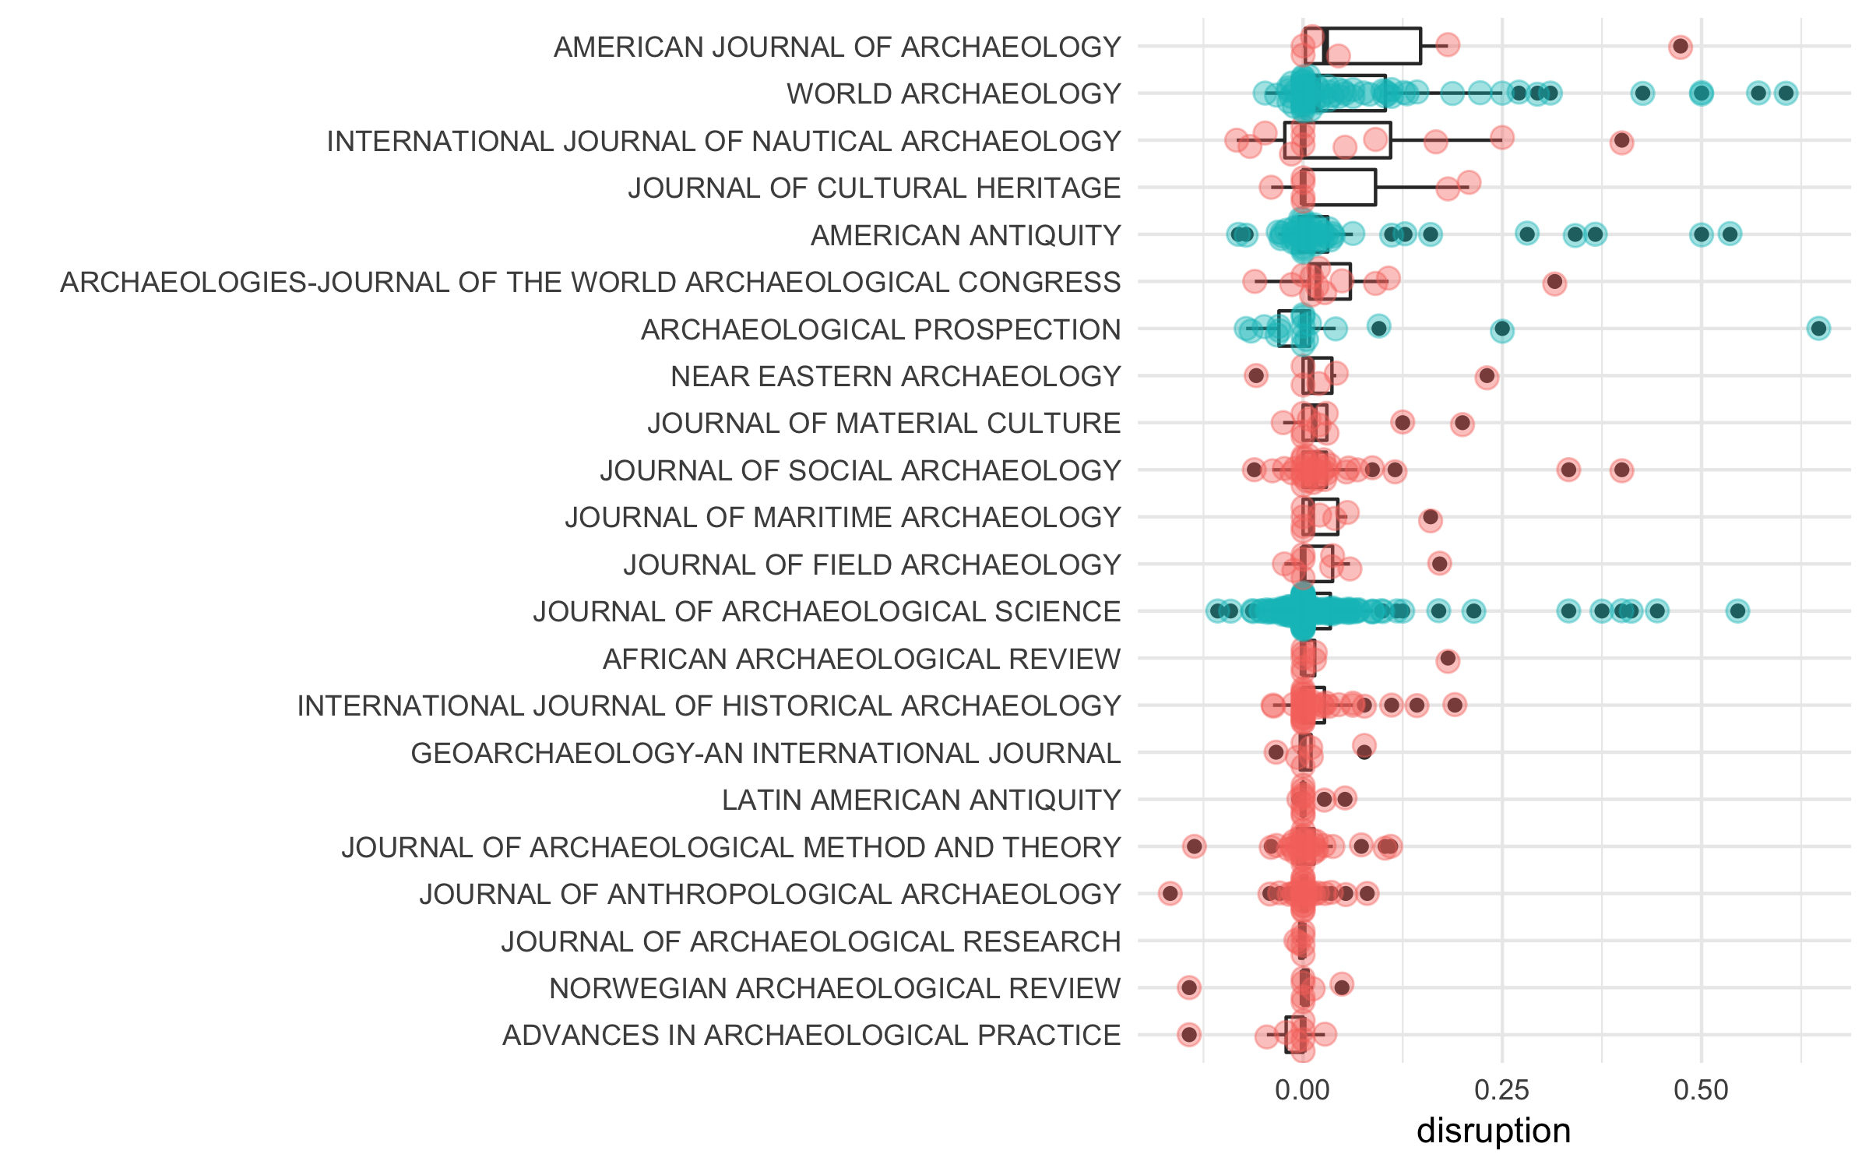

Slide 46
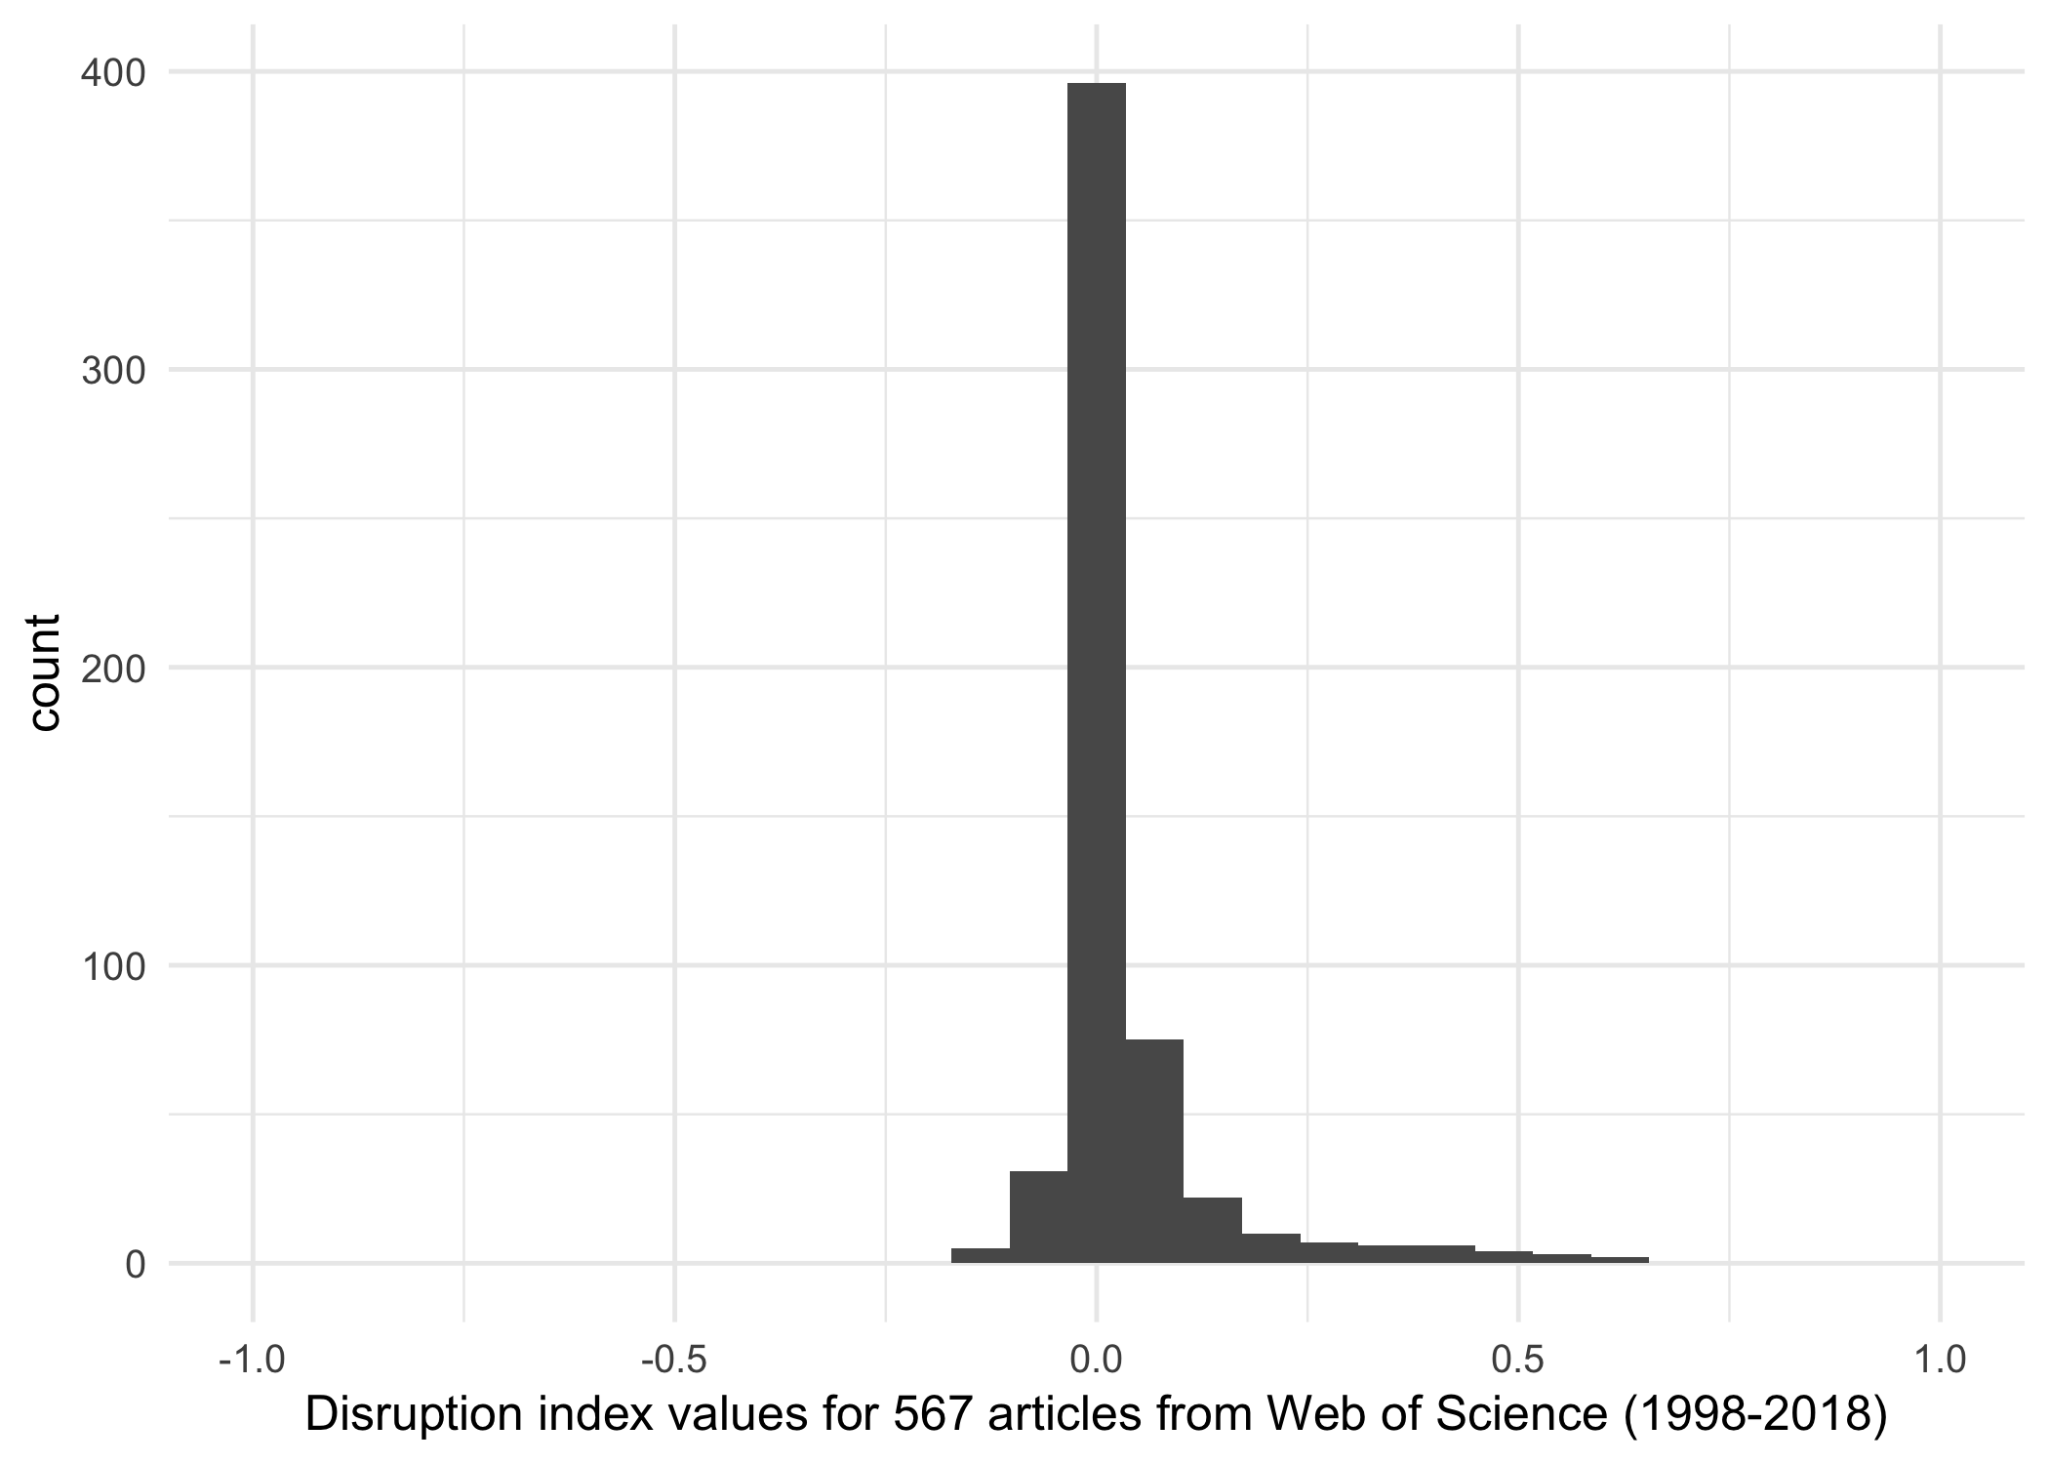

Slide 47
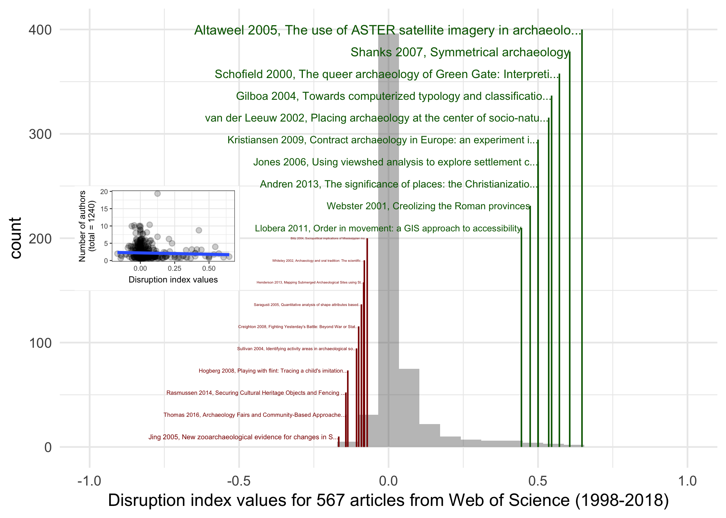

Slide 48
Remote sensing, GIS and computerized typologies are Big Data-ish work that has been disruptive in archaeology

Slide 49


Slide 50
Big Data gives us
Data Science

Slide 51
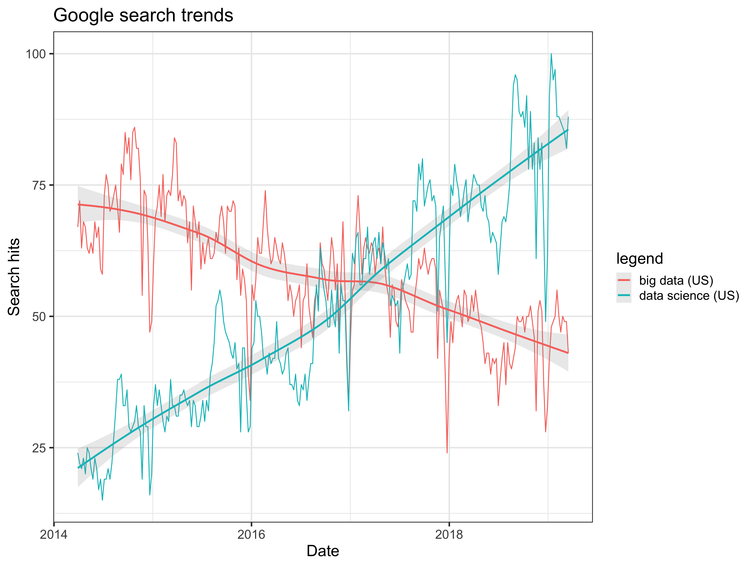

Slide 52
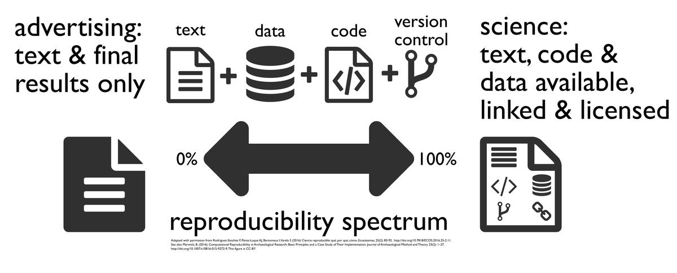
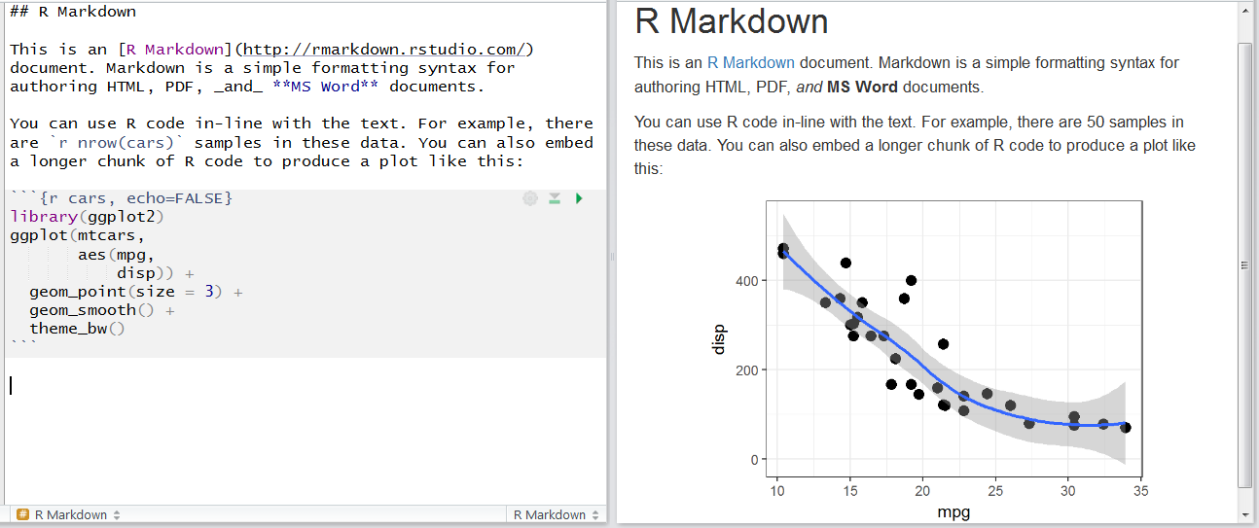

Slide 53
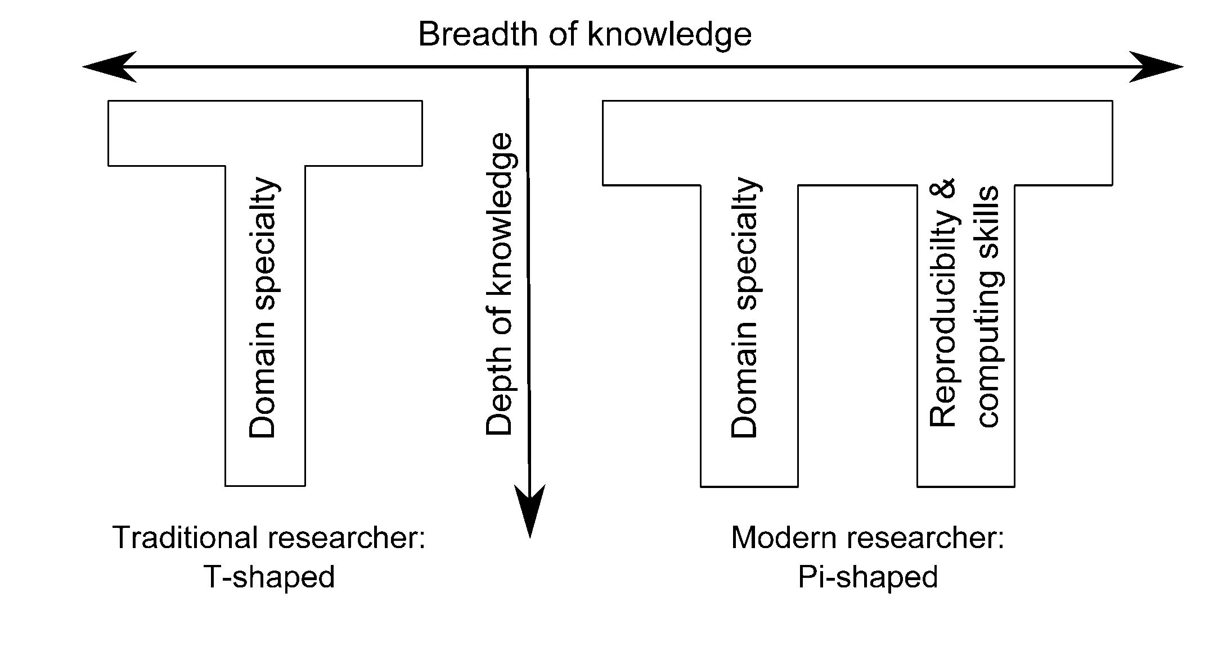
What are the implications for teaching, curriculum, and graduate programs?
Brittany Fiore-Gartland
Notes:
@misc{Fiore_Gartland_2017,
title={Hacked Ethnographic Fieldnotes},
url={https://medium.com/@dataethnography/hacked-ethnographic-fieldnotes-4e59bc95f4e5},
author={Brittany Fiore-Gartland},
note = {Accessed: 2018-09-30},
originalyear = {18.08.2017},
year={2017}
}

Slide 54
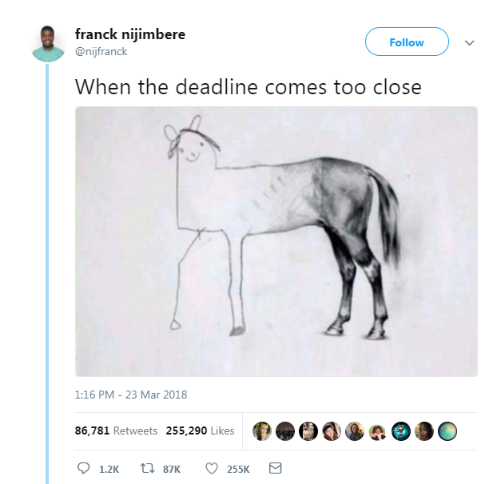

Slide 55
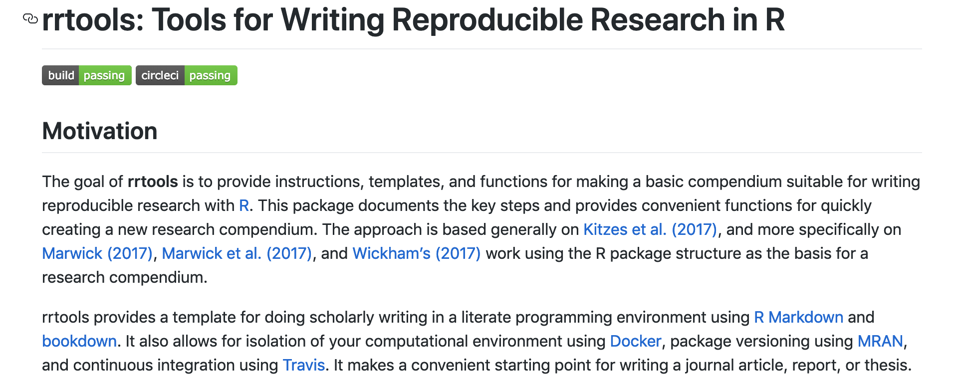
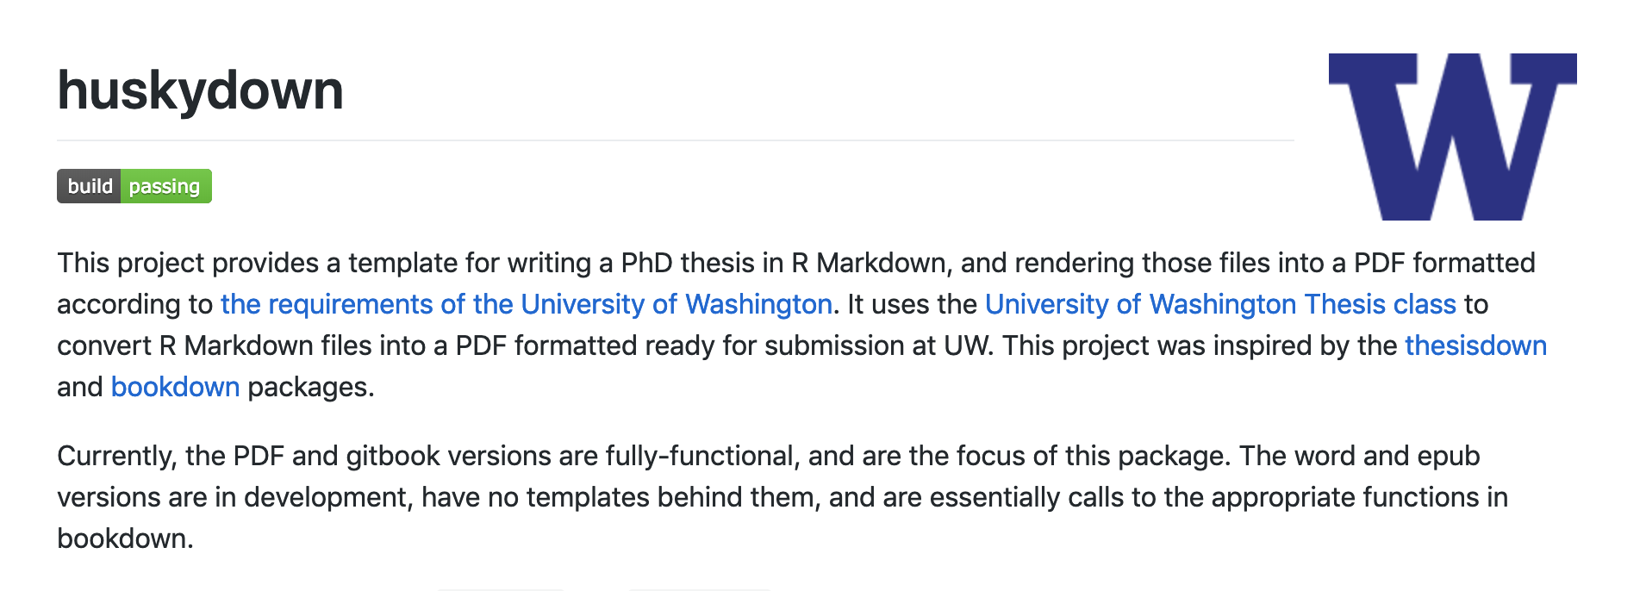

Slide 56



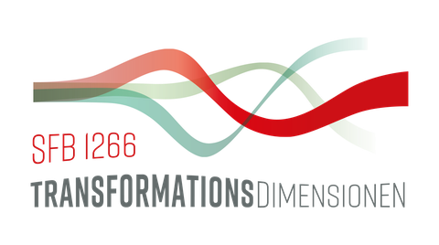
Acknowledgements
The rrtools project was developed during the 2017 Summer School on Reproducible Research in Landscape Archaeology at the Freie Universität Berlin (17-21 July), funded and jointly organized by Exc264 Topoi, CRC1266, and ISAAKiel.
Thanks to Sophie Schmidt, Daniel Knitter, Patrick Kennedy, Nils Müller-Scheeßel, Martin Hinz, Clemens Schmid, Ricarda Braun, Wojciech Francuzik for their contributions to the package.

